Slide 1
Investment Case Analysis
01

Slide 2
Overview
Asia | China | Latam | EMEA
NEUTRAL | POSITIVE | NEUTRAL | NEUTRAL

Slide 3
Overview
 | Macro | Fundamentals | Technicals | Valuation
Asia | Positive Inflation well anchored,growth robust,fiscal under control | Positive Decoupling of US & China,demographics and growth (india), easing cycle | Neutral Risk sentiment strong, potentially overbought | Negative Expensive, high profitability,decent earnings growth
China | Positive Monetary & Fiscal Stimulus,decent exports | Negative deleveraging,slowing growth,poor consumption | Positive Positive sentiment, underowned, RSI overbought | Positive Less cheap post rally, low profitability
Latam | Neutral Inflation anchored(ex Bra) ,growth robust,fiscal mixed,diverging Monetary Policy | Neutral Political Headwinds, dollar weakening tailwind | Neutral Poor Performance YTD, light positioning | Positive Cheap,cyclical,decent profitability
EMEA | Positive Decent growth, inflation under control, fiscal healthy | Neutral Geopolitically sensitive | Positive Diverging perf ytd, technical varied | Positive Cheap, diverging Earnings growth,

Slide 4
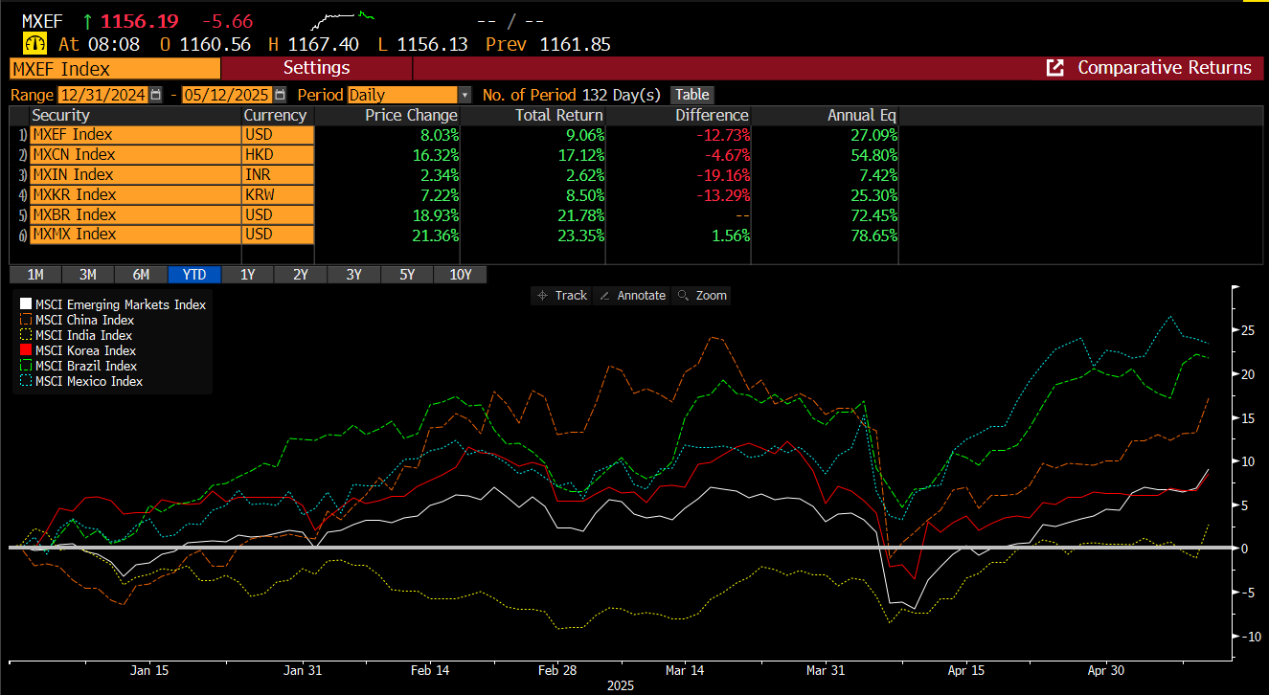
Performance Evolution YTD

Slide 5
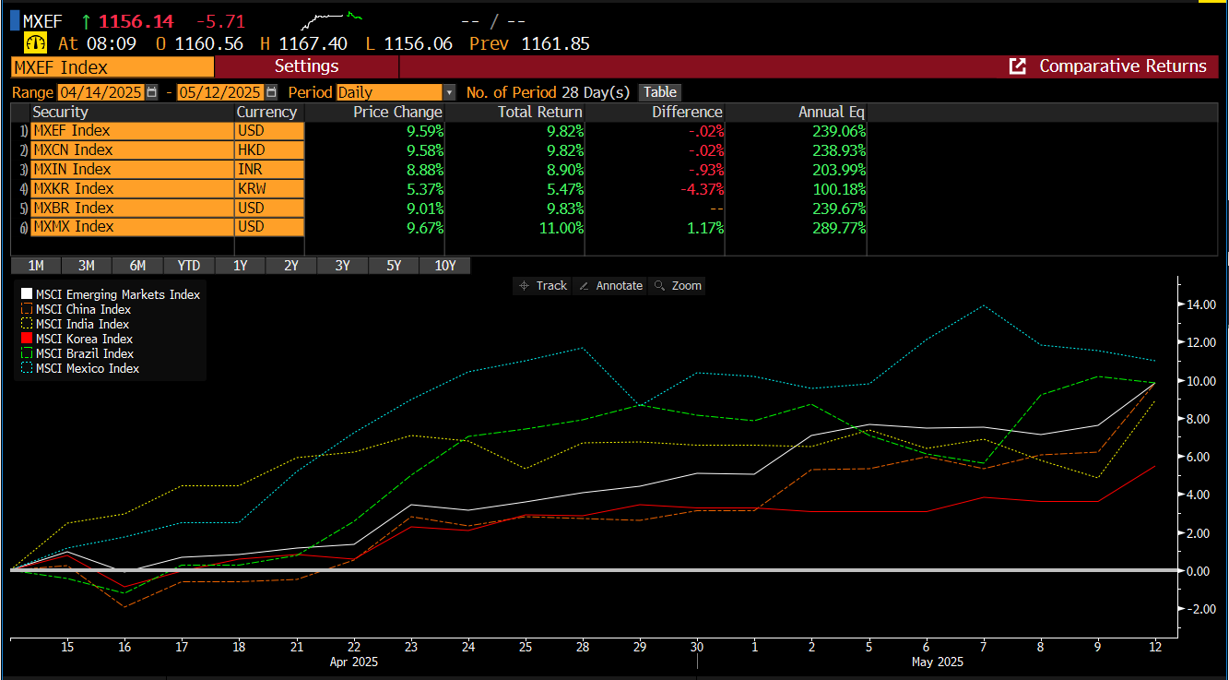
Performance Evolution since last Strategy day

Slide 6
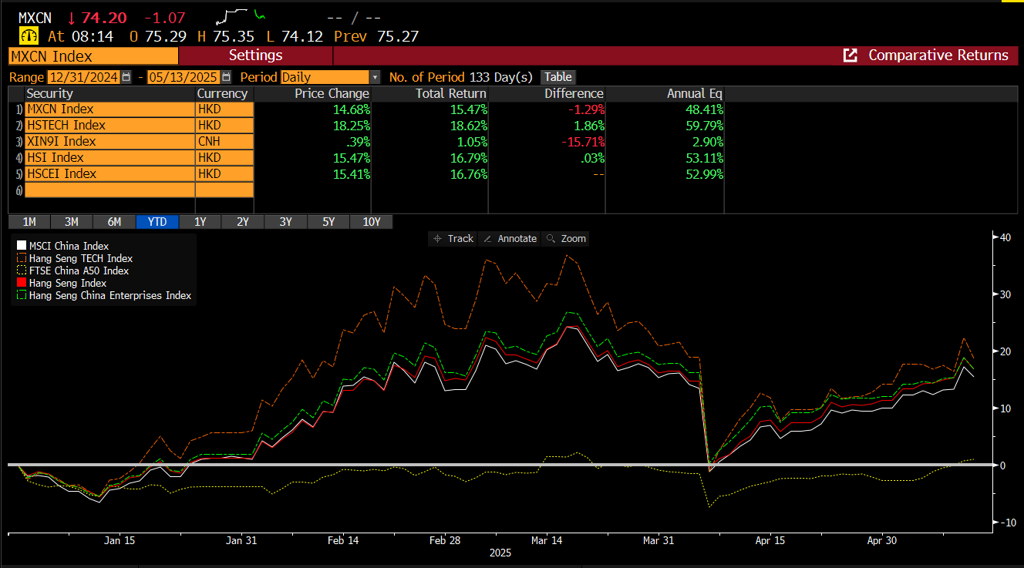
China Breakdown

Slide 7

Performance Evolution since last Strategy day

Slide 8




MSCI China (Long)
We recognize a clear policy pivot intention from the leadership, but we remain in wait and see mode. Chinese leadership is explicitly advocating for unconventional policies that include monetary easing and a more expansionary fiscal policy. This pivot is likely triggered by an atypical systemic crisis, where local governments were tight on money, struggling to pay corporates, banks and civil servants.
Monetary policy: Beijing has maintained a historically dovish stance, labelling monetary policy as “moderately loose”. Q2 as a possible window for the next reserve ratio requirements (RRR) and interest rate cuts as the current growth momentum runs out of steam amid higher tariffs and a weaker dollar creates policy space. PBoC has been preoccupied by the task of maintaining FX stability and reining in leverage in the bond market.
Fiscal policy: The highly-anticipated fiscal plan contains few surprises. The official budget deficit for 2025 was raised to around 4% of GDP from 3%, surpassing the peak reached at the start of the pandemic. This will be supplemented by off-balance-sheet borrowing by central and local governments, via special bond issuance, reaching RMB 6.2 trillion in 2025. Beijing has earmarked RMB 300 billion, out of the RMB 1.3 trillion special treasury bond issuance, to support the recently-expanded consumer subsidy scheme
In the case of aggressive trade protectionism policies and export controls from the Trump administration, China is likely to maintain this expansionary fiscal stance for longer. From 2025-2027 we can expect a consistent direction towards broad easing, reminiscent of Abe’s first and second arrows starting in 2012. In that case, a delayed fiscal consolidation is highly likely, with deficit maintained at 10% in 2026-2027 as well. However, we believe that the impact of these policies will not completely offset the existing structural drags. We expect China’s growth to remain on the downward trend, slowing from 4.8% this year to 4.1% in 2025, and 3.6% in 2026.
Chinese exports remained strong in Q4 amid exporters' front-loading efforts ahead of US tariffs, registering 14.3% yoy growth in real terms. Lower export prices continued to drag on nominal growth, and Chinese nominal exports grew 9.5% yoy in Q4.
Main risk factors:
Stimulus underwhelms and strong reversal
Macro continues to deteriorate and monetary policy is insufficient
Geopolitics flair up with US election approaching
Trump Tariffs impact growth
Taiwan
ECONOMIC
BACKDROP
We expect China’s growth to remain on the downward trend, slowing from 4.8% this year to 4.1% in 2025, and 3.6% in 2026. The upcoming package could help ease the drag from dis-leveraging in the past few years, but unlikely to reverse the course of structural slowdown.
VALUATION
MSCI China rerated aggressively to a PE of 13, closer to historical average. China equities PB also closed the discount vs broader EM index. The PBOC announcement on swap facility essentially created a dividend arb trade so we also saw high dividend names do well, Profitability quite poor (ROE at 11) and revisions still close to the worst in GEM
RISK / SENTIMENT
Risk sentiment was so poor for China throughout the year against the backdrop of its economic wows but also the geopolitical set up with the US .This obviously created the perfect set up for intervention from PBOC as sentiment couldn’t have been lower. If Stimulus underwhelms we could see a strong reversal. Chinese equities were very under owned with questions around invisibility and so many false dawns in terms of stimulus.
TECHNICAL
Still overall light institutonal investors positioning.Risk reward still good as flows were concentrated in the US over the last tweo years. Equally India benefited from China weakness over 23 and 24.

Slide 9
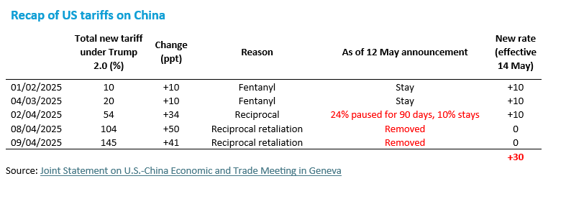
Recap of US tariffs on China

Slide 10
China/US Geneva outcome: initial take
the new tariff rate takes effects. As a result, an economic contraction can be averted in Q2. the upgrade does not fully restore our outlook to where we began (4.4% forecast at the start of 2025, vs 3.9% recently). Some damage is not reversible.
The weekend’s outcome significantly reduces the probability of China’s fiscal stimulus in Q3. We no longer expect major measures, as the 90-days pause buys enough time through mid-August. Even if talks stall or break down, tariffs will not revert to 145% but likely to 54%, a level that is easier to mitigate with domestic stimulus.
The reservation in easing indicates a shift away from the whole-hearted dedication to growth at the beginning of the year. To serve higher-level strategic goal – managing the decoupling with the US – PBoC and MoF need to reserve bullets to endure longer in the on- and off- economic war.
We keep forecasts of two additional 10bp rate cuts in July and September. As April CPI/PPI shows, deflationary pressures have been persistent, and further monetary easing is much needed regardless of the negotiation results.

Slide 11
PE for MSCI China close to historical average (both in mkt cap weighted and equally weighted terms). In a cross country comparison China is in the middle of the range. Macro fair value shows some upside at 12m horizon.

Slide 12
China revisions deteriorated furtherly for the second month in a row. Not exceptional EPS growth exp (IBES 10% above internal forecasts of 3%). Profitability quite poor. Institutional investors positioning quite light.

Slide 13
MSCI India (Neutral)
India stock market was quite weak since the end of Sept 2024 and for the first 4 months of this year; since then we observed some recovery. Some volatility recently due to the India - Pakistan turmoil. Valuations less stretched than in the past, notwithstanding the recent recovery. India appears quite insulated from tariffs risks. Internal EPS growth expectations stabilized close to a solid 10% (even if lower than IBES consensus, at 16%). Some marginal and bumpy improvement in revisions (still negative). Profitability quite attractive.
India remains a structural story of reforms and digital transformation. The country is becoming more important in financial markets. Strong Manufacturing data from electronics. Government incentives with a skilled workforce (apple supply chain)
Some growth moderation seen recently, with weaker capex. However, GDP perspectives continue to stand out (towards 6-7%) and remain a bright spot in a world of growth scarcity.
On the positive side, we can also mention that India seems overall insulated by geopolitical risks. More exposed to risks coming from commodity prices.
Earnings dynamic is recovering but still to be closely monitored
Main risk factors:
Valuation is not cheap and vulnerable from re rating in strong risk off move
Earnings dynamic to monitor
Oil price is a key determinant for India.
China new stimulus could drive flows out of India.
ECONOMIC
BACKDROP
India has shown some growth moderation recently, with weaker capex. However, GDP perspectives continue to stand out (towards 6-7%) and remain a bright spot in a world of growth scarcity. RBI has continued the easing cycle, cutting furtherly on 9th April and other 25bps cut is expected,
VALUATION
Valuations less stretched than in the past, notwithstanding the recent recovery. India appears quite insulated from tariffs risks. Internal EPS growth expectations stabilized close to a solid 10% (even if lower than IBES consensus, at 16%). Some marginal and bumpy improvement in revisions (still negative). Profitability quite attractive.
RISK / SENTIMENT
India- Pakistan turmoil remains a risk. On the supportive side, India remains quite insulated from Trump tariffs risk bottoming out signal is also confirmed by some marginal and bumpy improvement in revisions (still negative).
TECHNICAL
Local equity support has been a major technical tailwind for the country. This combined with international reallocation away from China equities to India has supported the market in 2024. Since the China stimulus announcment the technicals have become weaker for India. India is a consensus long for long term investors.

Slide 14
PE for MSCI India structurally expensive vs history (both in mkt cap weighted and equally weighted terms). Macro fair value shows quite positive upside at 12m horizon.

Slide 15
Internal EPS growth expectations stabilized close to a solid 10% (even if lower than IBES consensus, at 16%). Some marginal and bumpy improvement in revisions (still negative). Quite stable and high profitability. Institutional investors positioning not negligible.
State Street run a revisions of historical time series in April that created some discontinuity

Slide 16
Quant Analysis
03

Slide 17
Appendix
04

Slide 18
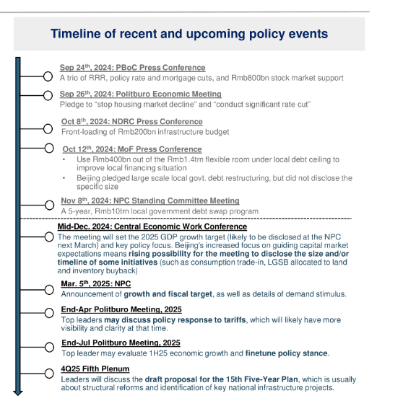
Source: Amundi Investment Institute. Data is as of 04 November 2024.

Slide 19
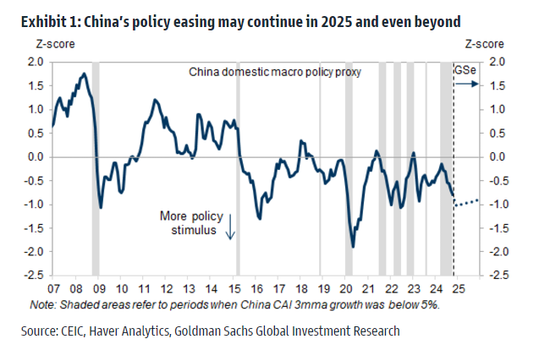
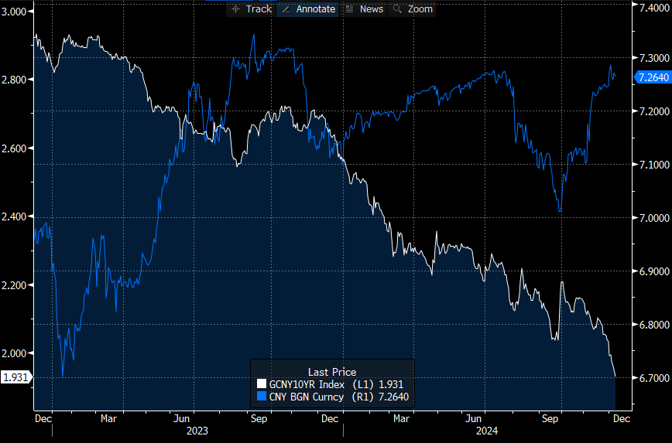
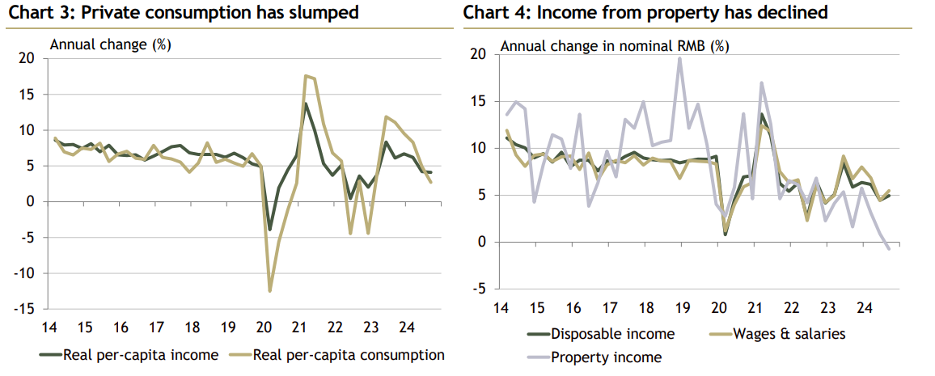
China Politburo pledged to take “extraordinary counter cyclical” policies, is it already happening ?
Source: Amundi Investment Institute. Data is as of 04 November 2024.

Slide 20
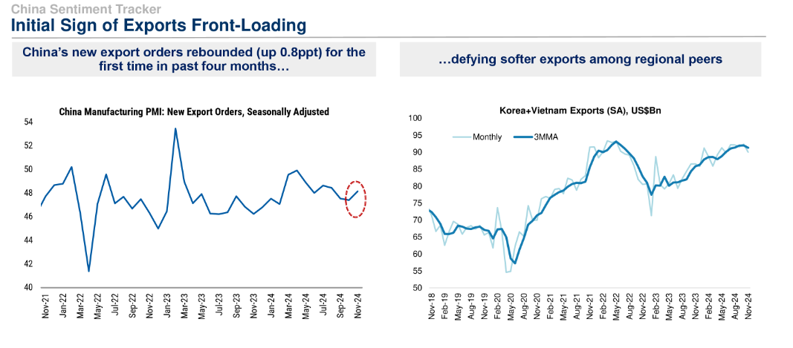
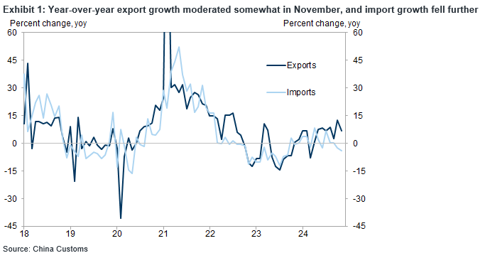
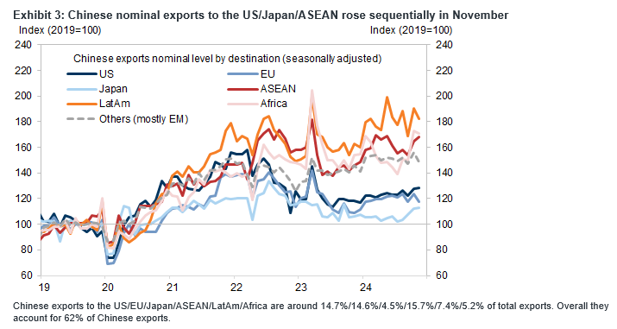
Exports remain robust helped by frontloading

Slide 21
Trump Tariffs Impact
Source: Amundi Investment Institute. Data is as of 04 November 2024.

Slide 22
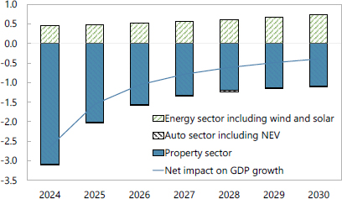
New growth engines: not enough to replace property
IMF 2024 Article IV: The authorities aim to counter headwinds to growth by promoting “new productive forces.” However, the focus remains on supply-side policies, notably industrial policies to support manufacturing broadly and emerging sectors such as electric vehicles (EVs), green technologies, and semiconductors. While these sectors can support growth, they are unlikely to replace the drag from the property sector.
Source: IMF staff calculations. From: International Monetary Fund. Asia and Pacific Dept. People’s Republic of China: 2024 Article IV Consultation-Press Release; Staff Report; and Statement by the Executive Director for the People’s Republic of China. IMF Staff Country Reports. 2024;2024(258):A001. doi:10.5089/9798400284281.002.A001. Source: IMF staff calculations.
Contribution to GDP Growth Relative to 2010-2020 Average (Percentage points).

Slide 23
China’s counter containment: going to the new market
Before Covid, Global South market is similar to US+EU, now it is 50% bigger
Market size
GDP, USDbn
 | 2023 | 2029 | CAGR (% 2023-2029)
US | 27,721 | 35,458 | 4.2
EU | 18,579 | 23,374 | 3.9
Global South | 22,130 | 31,173 | 5.9
GDP per capita, PPP
 | 2023 | 2029 | Ratio: 2029/2023
US | 82,715 | 102,987 | 1.25
EU | 60,688 | 73,751 | 1.22
Global South | 25,457 | 32,275 | 1.27
Source: IMF, CEIC, Amundi Investment Institute.

Slide 24
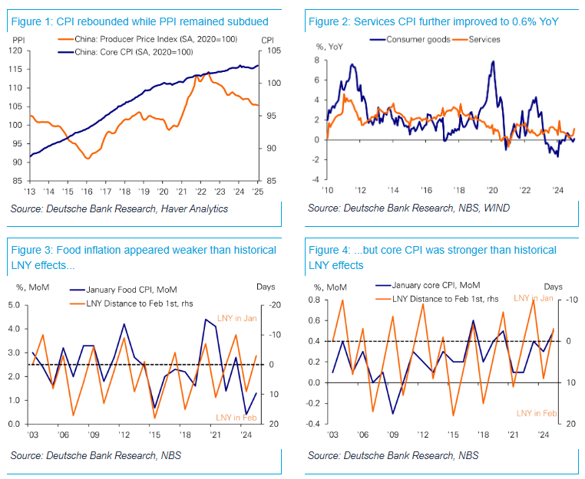
China Inflation Picture

Slide 25
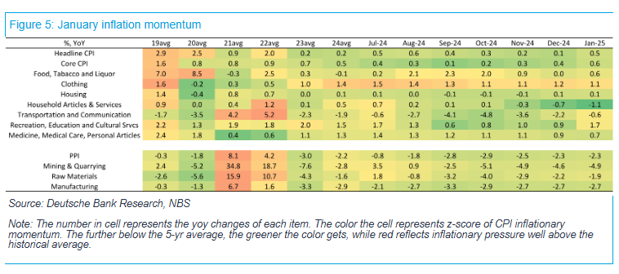
China Inflation Picture
Source: S&P, CEIC, Amundi Investment Institute

Slide 26
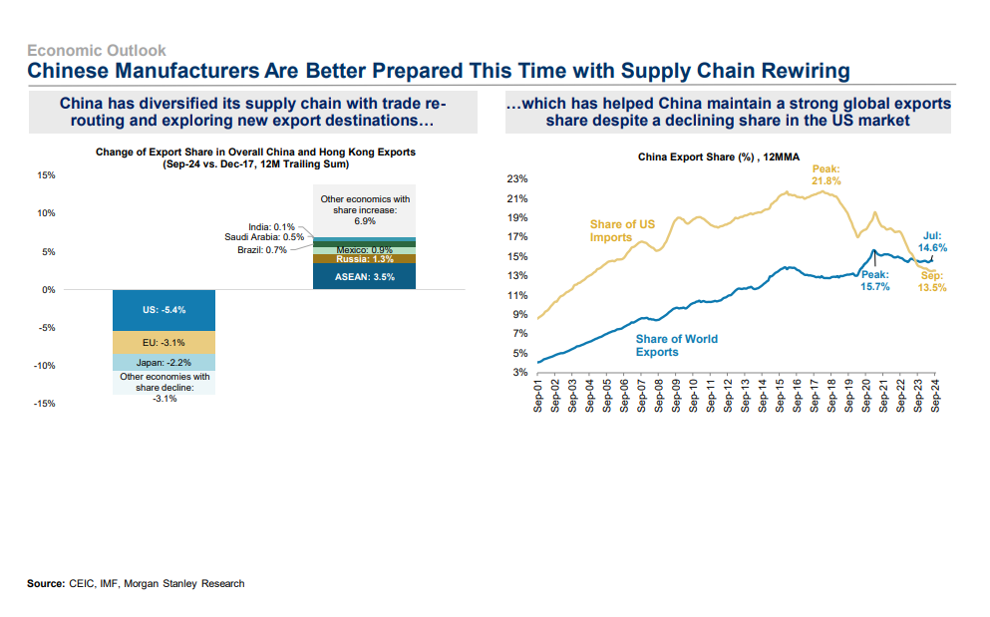
Trump Tariffs Impact
Source: Amundi Investment Institute. Data is as of 04 November 2024.

Slide 27
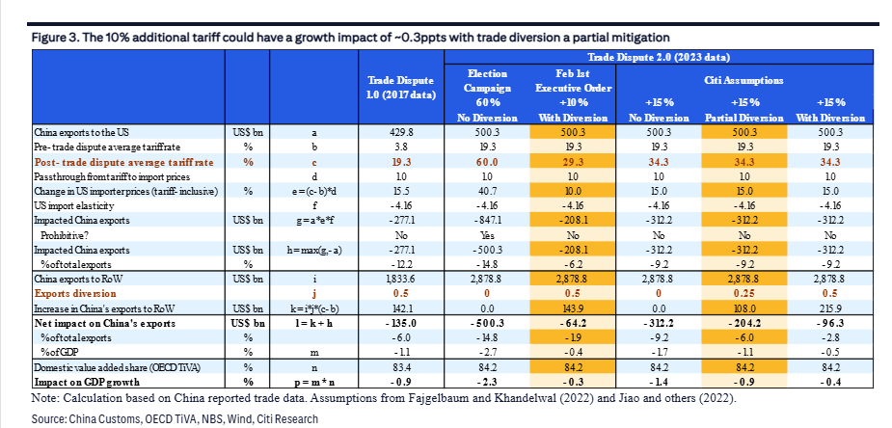
Trump 2.0: decoupling weighs on cyclical and productivity growth
Trade rerouting, increased fiscal stimulus to offset some US policy impacts, not completely

Slide 28
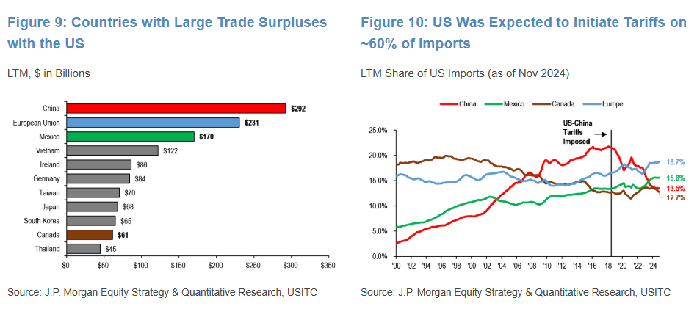
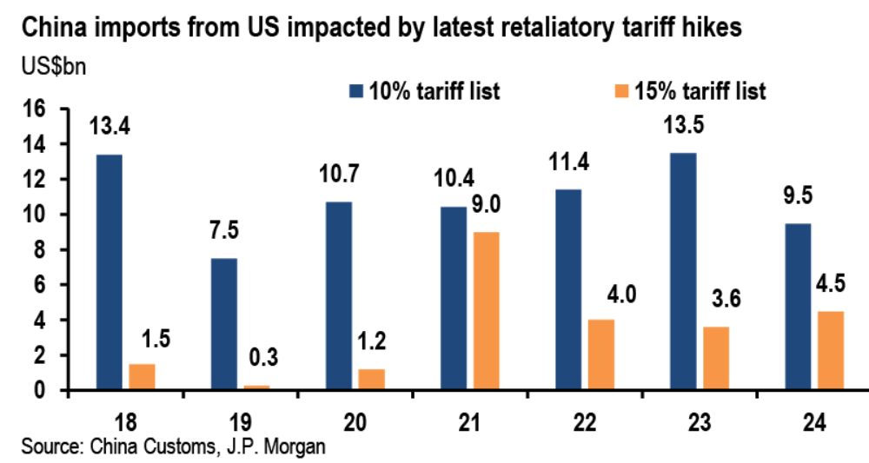
Trade Challenges and Tarrifs

Slide 29



Mexico (Neutral)
GDP Growth expected at +0.1% (revised lower from 0.8%) in 2025 and +1.6% in 2026 (internal): Soft economy hit by a negative demand shock is likely to contract this year according to the IMF
Easing Cycle: in march policy rates have been cut by 50bps. now at 9.0%. Banxico will be cutting at a relative fast pace (50bps/meeting) for a bit longer given the soft growth outlook and within targe range inflation as long as MXN behaves. We see policy rates coming down to 7% by the end of the year.
Fiscal side: The admin is prioritising macro stability over growth. Large fiscal consolidation (from 5.7% deficit in ’24 to around 4% of GDP) is likely to happen despite soft growth. Fiscal reform is not out of the question but not yet being considered.
Tariff: Mexico remains a relative winner in the tariff story, with the effective tariff rate at ~7% and the potential for it to be revised further downwards.
Flows have been very negative in 2024, a little bit of recovery YTD. Data points to foreign flows been heavily impacted as consensus has moved more negative. This gives us a cleaner positioning to benefit from a recovery.
Main risk factors:
Reform risks could erode the institutional framework and investor confidence. US officials, and the broad business community have expressed concerns about the approval of the judicial system reform due to uncertainty and potential erosion of the institutional and legal frameworks.
U.S. recession risks could bring further downside to an already negative economic backdrop for Mexico
The speed in which both US and Mexico GDP is deteriorating gives cause for concern. GDP revised down at 0.1% with risks skewed towards recession if trade tension should resume.
ECONOMIC
BACKDROP
GDP data show Mexican activity has lost momentum after strong growth over most of the past two years. We expect +0.1% in 2025 and +1.6% in 2026..Banxico cutting cycle will continue.
VALUATION
Very cheap valuation (~11x forward P/E, which is ~2SD below historical averages). Q4 2024 reporting season showed positive Y0Y results (+7%) till now. EPS growth expectations (IBES) quite posiitve (+16%). Revisions improving.
RISK / SENTIMENT
Mixed risk sentiment: a lot of volatility due to Trump tariff and afterwords the agreement with Claudia postponing tariff for 1 month. Probably the peak negativity has passed and Claudia should refocused on Nearshoring. After the rally, we could see some consolidation.
TECHNICAL
Light institutional investors positioning after the sell off post elections, both on MXN and Equity. This gives Positioning, while improving, remains light relative to historical for both foreigners and locals; and while decelerating, companies’ earnings have remained quite resilient and with bottom-up fundamentals largely in place.

Slide 30
MEX Comment: Let the Tariff Games Begin
•Even without Lighthizer on board (it will be his protégé Greer, in fact), the POTUS-elect announced on Monday evening an intention to impose (conditional) tariffs on Mexico (and Canada) set at a large 25%-not a gradual start by any means -after taking the office in late Jan. The trade tax would remain in place until the flow of fentanyl and illegal crossings came to a halt. Additionally, China was threatened with a ‘mere’ 10% tariff.
•We expected early (not so) friendly USMCA/Mexico aimed fire, similar to how things played out eight years ago –see the exhibit on top for a timeline -, in light of a whole lot of issues between both nations (immigration, fentanyl, security cooperation, Chinese investment, AMLO’s policies not compliant with USMCA etc) . After all, Mexico appears to be an easy target and a good place to start shoring up the domestic turf which could also serve to teach others a lesson.
•What we didn’t fully expect was Mexico’s Claudia’s more hawkish response, in which she threatened retaliatory tariffs. She also mentioned cooperating on drug and immigration demands, but markets focused rather on the former. The more assertive response may be related to Claudia’s landslide electoral victory over the summer; she won a constitutional majority, allowing her to pass AMLO’s less than benign (anti)reforms and might have encouraged her now to appeal to the Morena base with more pointed remarks. Too bad Claudia is becoming a victim of her own success in the process.
•But I suspect Claudia will fall in line (like Canada’s Trudeau) and do ‘whatever it takes’ to appease Trump rather than risk a very damaging, if not lethal, trade war (e.g. restart of the Remain in Mexico 2.0 program, much bigger security cooperation, a tighter rule of origin when renegotiating USMCA etc). Trump’s tariff bazooka is, after all, significantly bigger –he could go after massive remittances next (via another tax) –and might not refrain from using it since he can’t afford to lose the first scrimmage that would make all his future battles more difficult. The quicker Claudia comes to terms with it, the better.

Slide 31
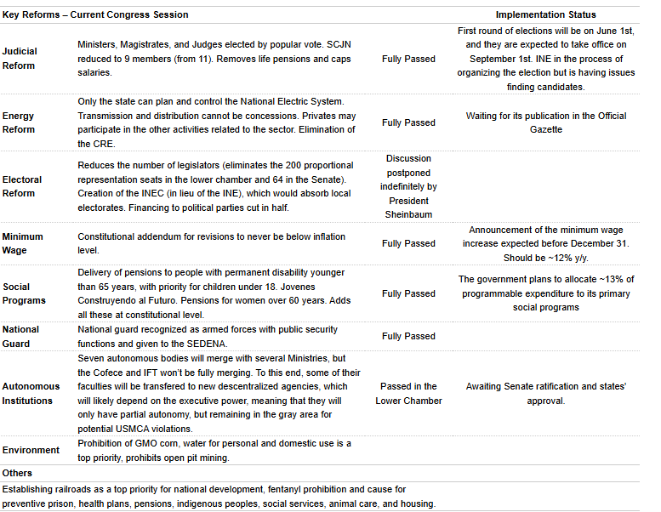
MEX Reforms

Slide 32
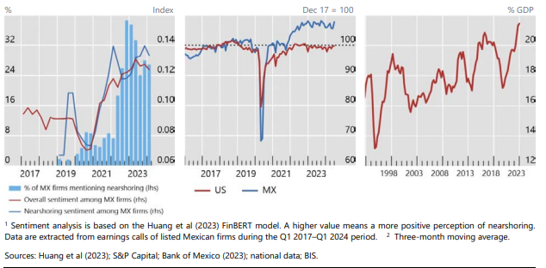
Nearshoring Evidence As Seen By BIS
Plenty of appetite, some signs of it but not much hard evidence of actual nearshoring
Nearshoring sentiment clearly in place
Manufacturing output outperformed while US production softish
Pvt Capex/GDP picked up visibly

Slide 33
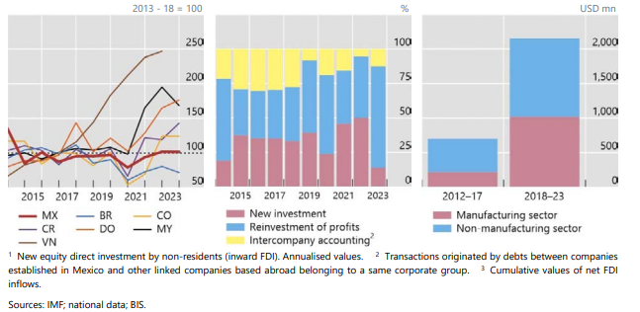
Nearshoring: “Don’t Tell Me, Show Me"
Still, (overall) FDI inflows into MEX soft vs peers
But FDI composition clearly rotated towards reinvestment of profits at the expense of new FDI indicating spillovers of US re-shoring underway (production is re-allocating to MEX via expansion of existing capacity atm)
Chinese FDI picked up visibly since tariffs introduced (from low starting point; 1.2% of total CHN FDI).
FT reported the stock of CHN FDI might be 6X the reported

Slide 34
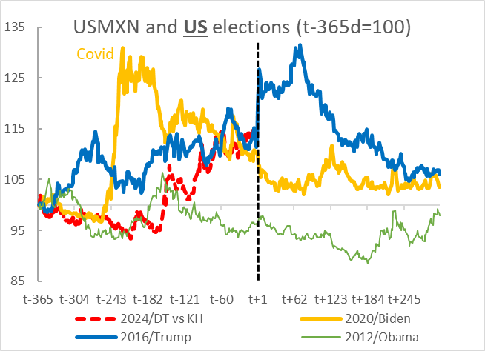
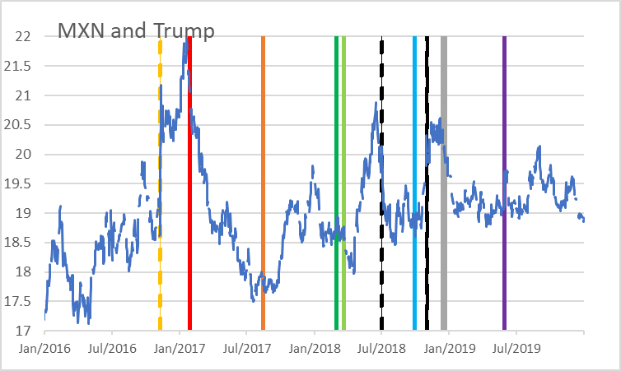
Mexico and Trump 2.0: Short term pain, (still) long term gain?
i) ‘Exceptional’ US economy ultimately a tailwinds for MEX eco act (tariffs permitting), ii) US needs MEX to re/nearshore – USMCA in place (but macro stability will be key), iii) cheaper MXN a tailwind for nearshoring, iv) Trump to sort out MEX domestic mess,
iv) Claudia will adopt ‘whatever it takes’ to appease Trump. But first, Trump has a big mandate to sort of immigration, fentanyl and trade imbalances…Tariffs to serve as a pressuring tool as they did in 2017-19. FX to act as a shock absorber/automatic stabiliser.
Fentanyl trade/security cooperation → Cooperation will increase but not easy to fix as demand created by supply
Remittances? → If targeted with taxes, cheaper MXN will offset smaller nominal transfers
Large tailwinds for BoP
Immigration/Remain in Mexico 2.0 → Positive supply shock if reinstated
Not very expensive fiscally (local pop social benefits not to be extended).
Tight labour market now weakening – harder to absorb newcomers
South American migrants have the language and culture on their side
China investment in MEX and backdoor exports to US → (USMCA) Rule of origin to be tightened
Stock of CHN FDI to be a multiple of the reported numbers

Slide 35
LatAm Exposure to Trump 2.0
Geopolitics on LatAm’s side. Trade positions favourable (except for MEX but US needs its USMCA sidekick to neutralise CHN). Some commodity demand driven by structural forces (copper etc).
BRA: Indirect via China, commodities.
Trump and Lula don’t like each other. The latter is seriously entertaining joining CHN’s Belt and Road. Secondary in importance,
China, a huge trading partner of Brazil. Via Commodities. Few small areas of mfg goods exposure.
Mitigating factors:
Fiscal situation stretched, monetary policy dictated by fiscal and BRL.
At least external exposure is solid/smaller and starting point for growth strong
2. MEX: DIRECT and Massive
Trade, remittances. Financial conditions and high Beta market
Areas of friction: immigration, genetically modified corn, illegal drugs, security cooperation, AMLO’s reforms not complaint with USMCA, USMCA sunset clause, CHN FDI in MEX…
Mitigating factors:
Fiscal room gone. Plenty of monetary but not very efficient transmission mechanism
Enemy of my competitor an ally + US needs MEX to onshore/nearshore…
Cheaper MXN will accelerate nearshoring
3. CHL and PER: Indirect via CHN and commodities
CHL: Less externally exposed, cooper driven by structural demand, politically CHL looks far more stable
PER: Large CHN investment in place, external exposure small (solid BoP)
4. ARG: would benefit from Trump victory
Milei a fan of Trump and vice versa
IMF could provide fresh money far more easily

Slide 36
Overview of some countries in our radar
EM Asia MT valuations (PE vs history) : Indonesia and Korea cheap
Korea: cheap
Indonesia: cheap

Slide 37
Overview of some countries in our radar
Latam MT (PE vs history) valuations: Mexico deteriorated in terms of valuation after recent rally. However still cheap in the medium term, especially in MKT weighted terms. Brazil cheaper in equally weighted terms
Mexico: cheap
Brazil: cheap

Slide 38
Overview of some countries in our radar: Mexico and Brazil: overall good fundamentals, still low positioning. A pause in the rally makes sense. Not yet time to enter Indonesia (bad revisions). Korea improved in terms of fundamentals and now is more attractive.
Korea 12m EPS growth consensus exp (IBES) stabilized recently at double digit growth, much higher than internal forecasts (negative) but lower than trailings. Revisions still good even if marginally deteriorating in the last month. Low institutionals investors positioning. Profitability stiill quite poor (9%)
On the other side, good profitability for Indonesia. Still light positioning. On the other side EPS growth exp are low (+1.6%). Revisions the lowest in GEM.
Mexico is middle range in terms of EPS growth exp (+13%) and ROE (12.3), Rrevisions deteriorating. Very light positioning.
Brazil IBES EPS growth exp lower than our internal ones (double digit). Marginally improving revisions in a cross countries comparison. Light positioning

Slide 39
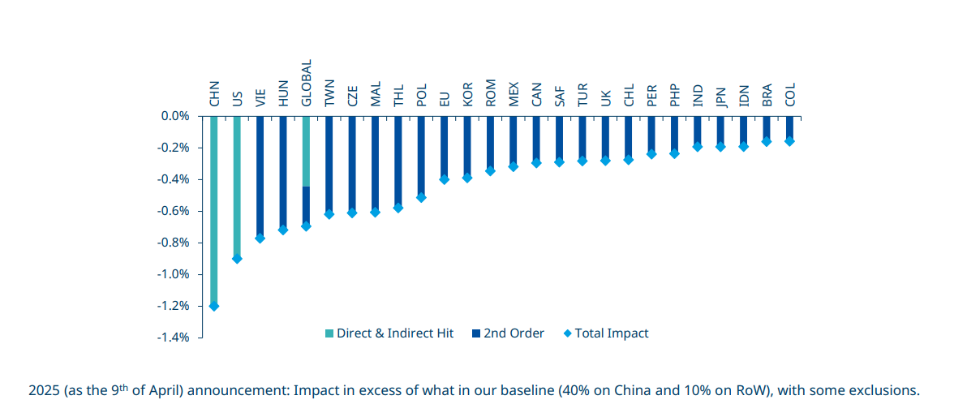
Tariffs Impact Assessment

Slide 40
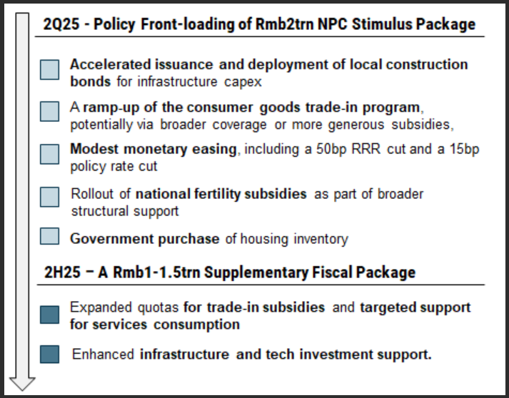

Slide 41
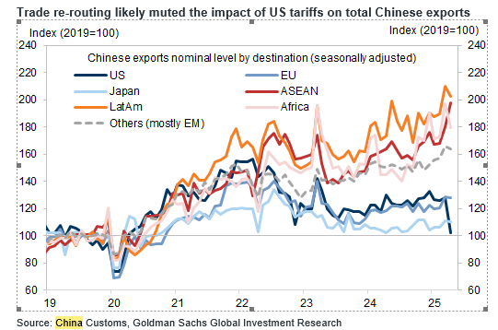
Trade re-routing likely muted the impact of US tariffs on total Chinese exports

Slide 42
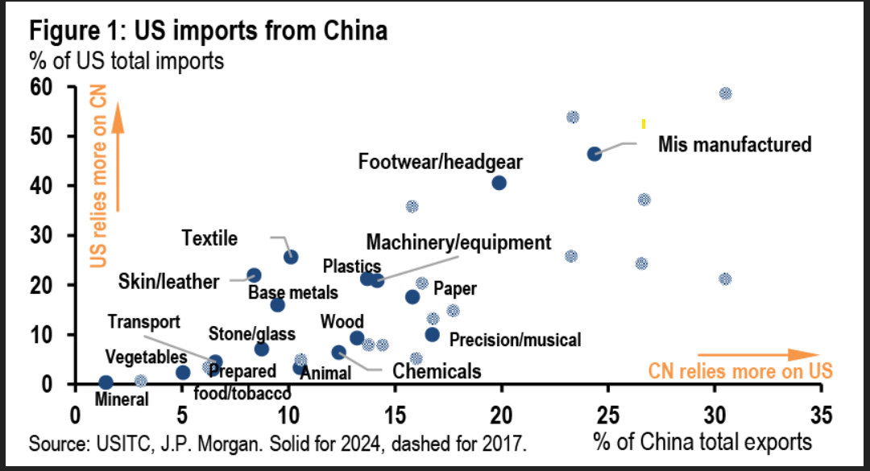
Composition

Slide 43
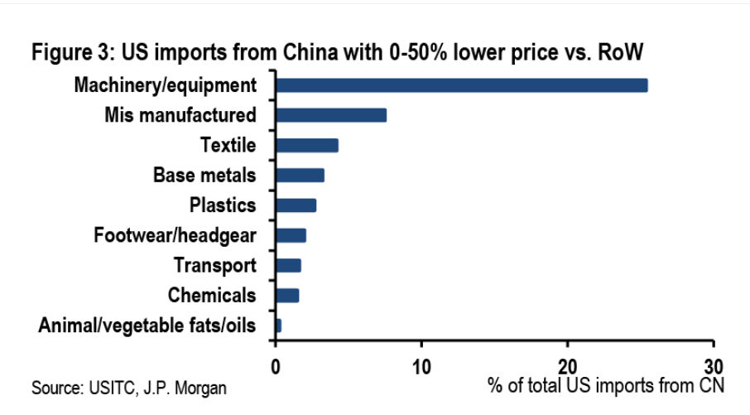
China’s competitive advantage in areas is stark

Slide 44
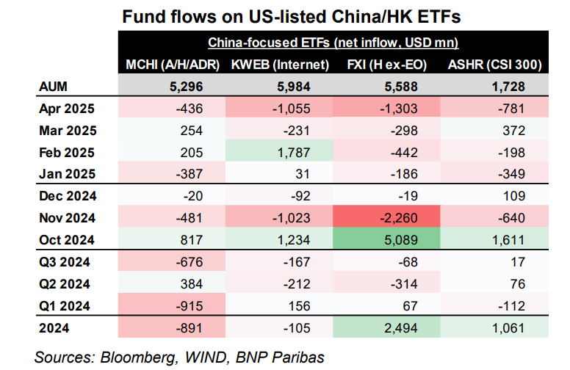
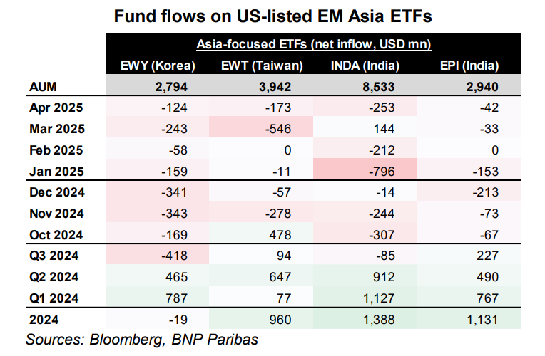
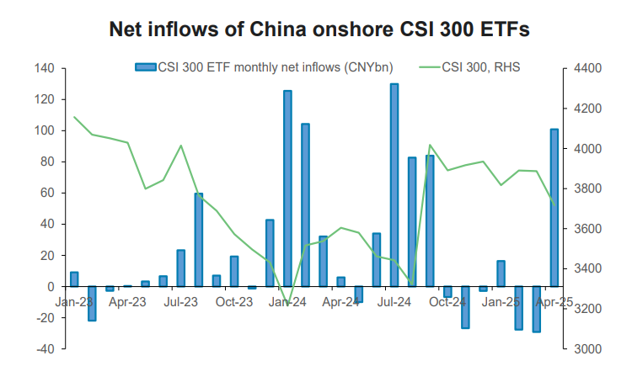
Flow data

Slide 45
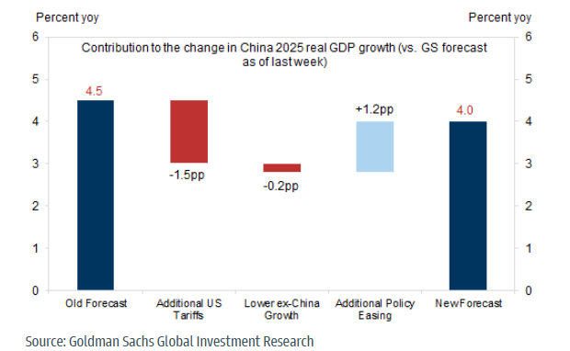
Flow data

Slide 46
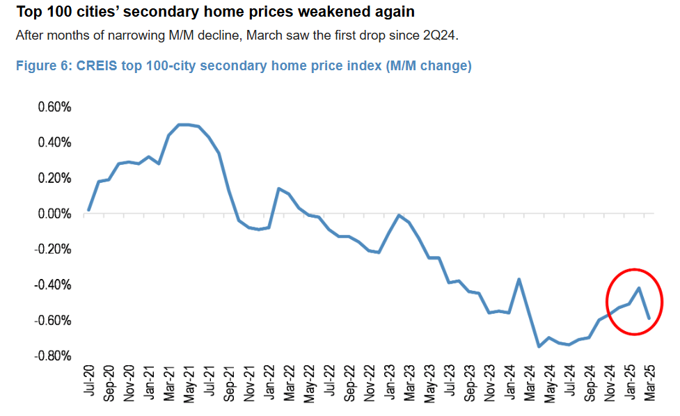
Positioning and Flows

Slide 47
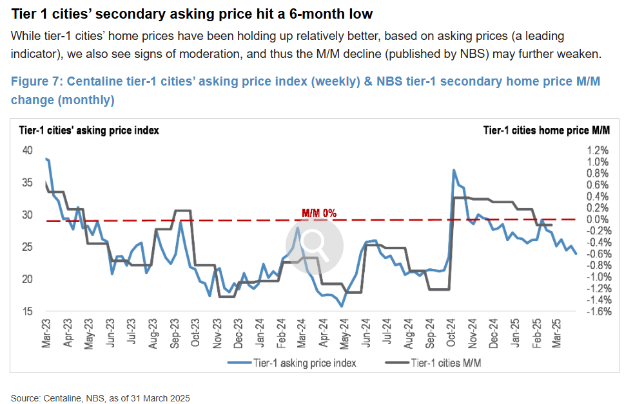
Positioning and Flows

Slide 48
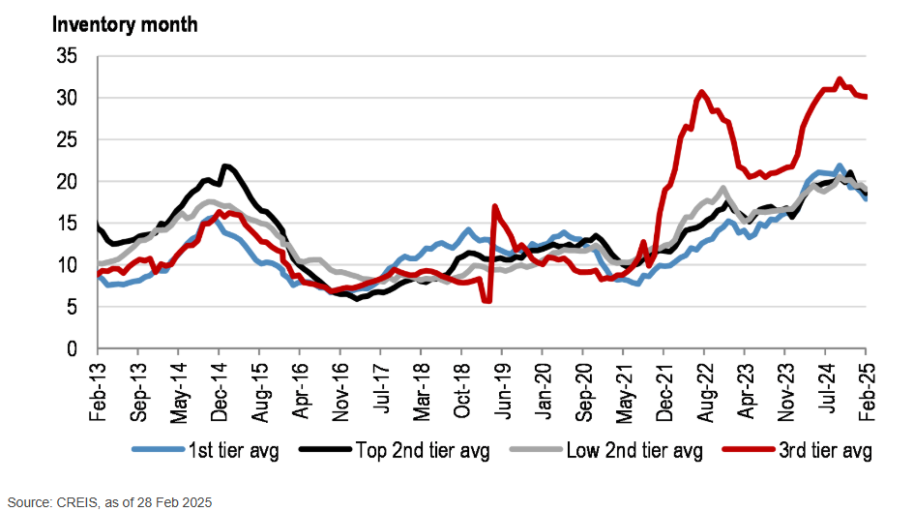
Positioning and Flows

Slide 49
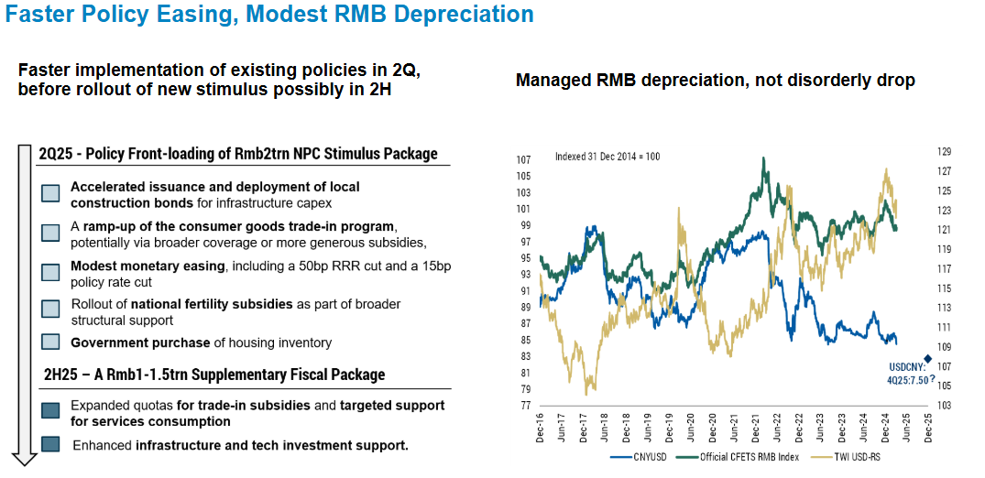
Positioning and Flows

Slide 50
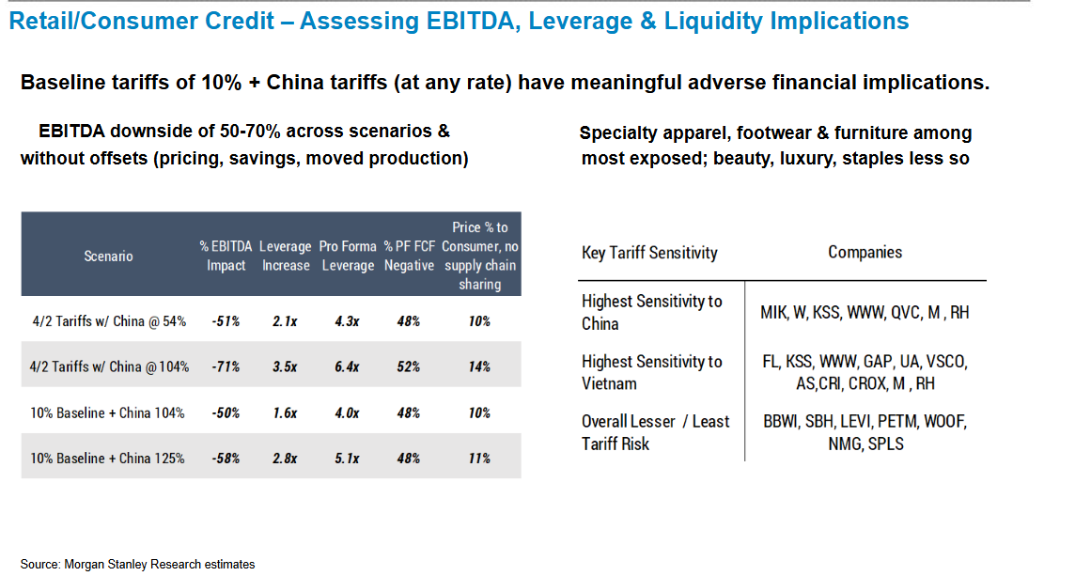
Positioning and Flows

Slide 51
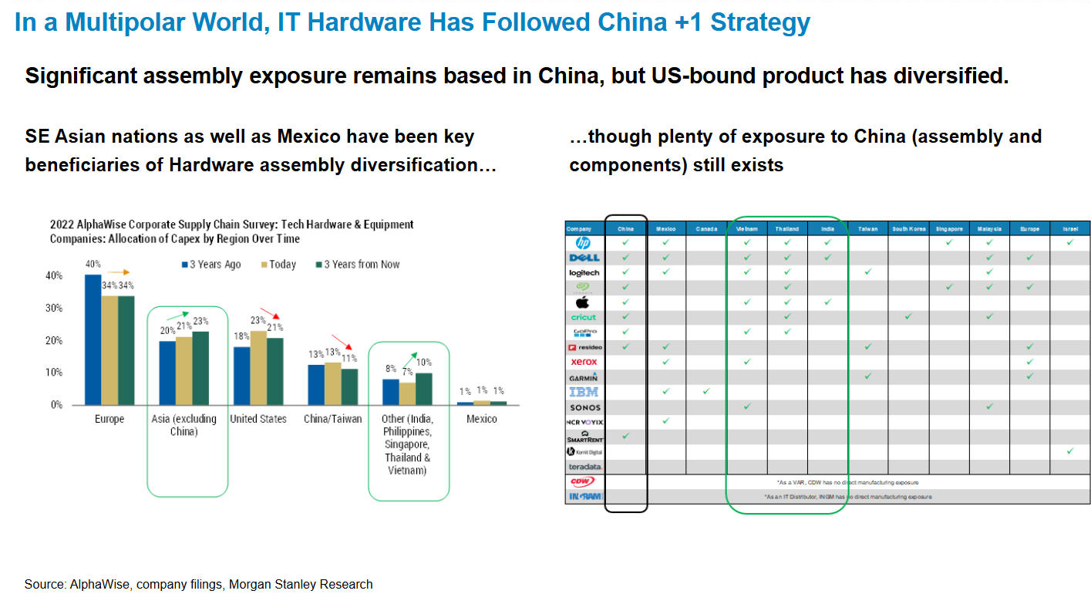
Export Growth Slowing
Source: UBS

Slide 52
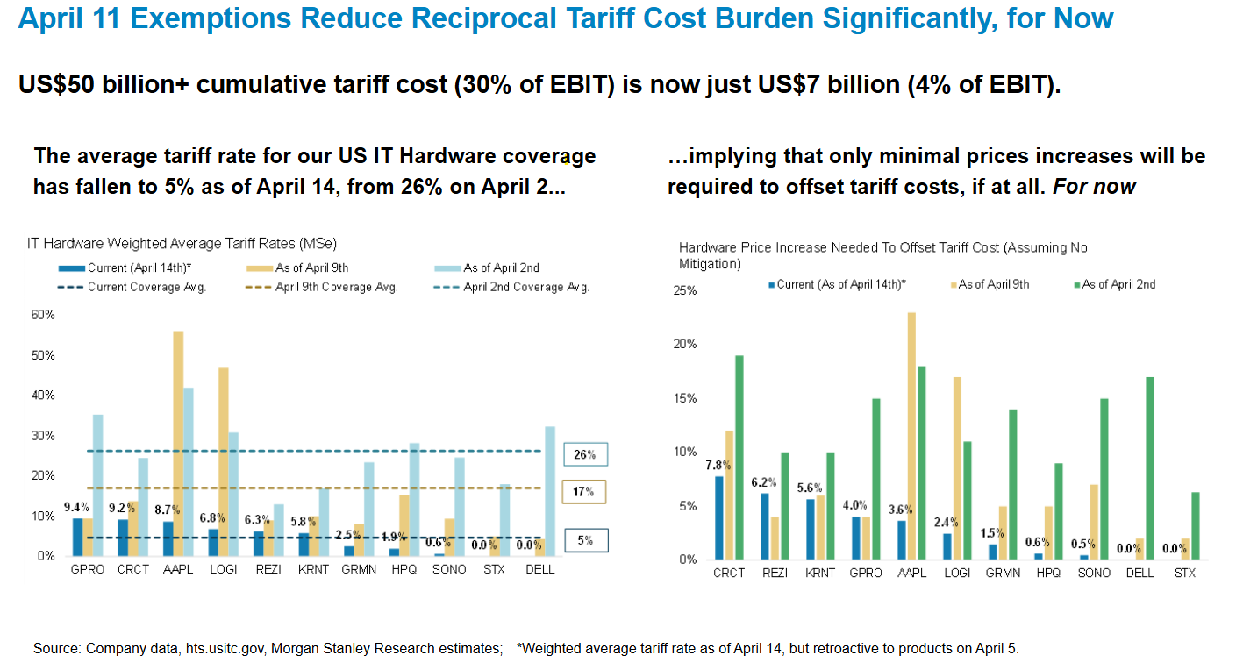
Export Growth Slowing
Source: UBS

Slide 53
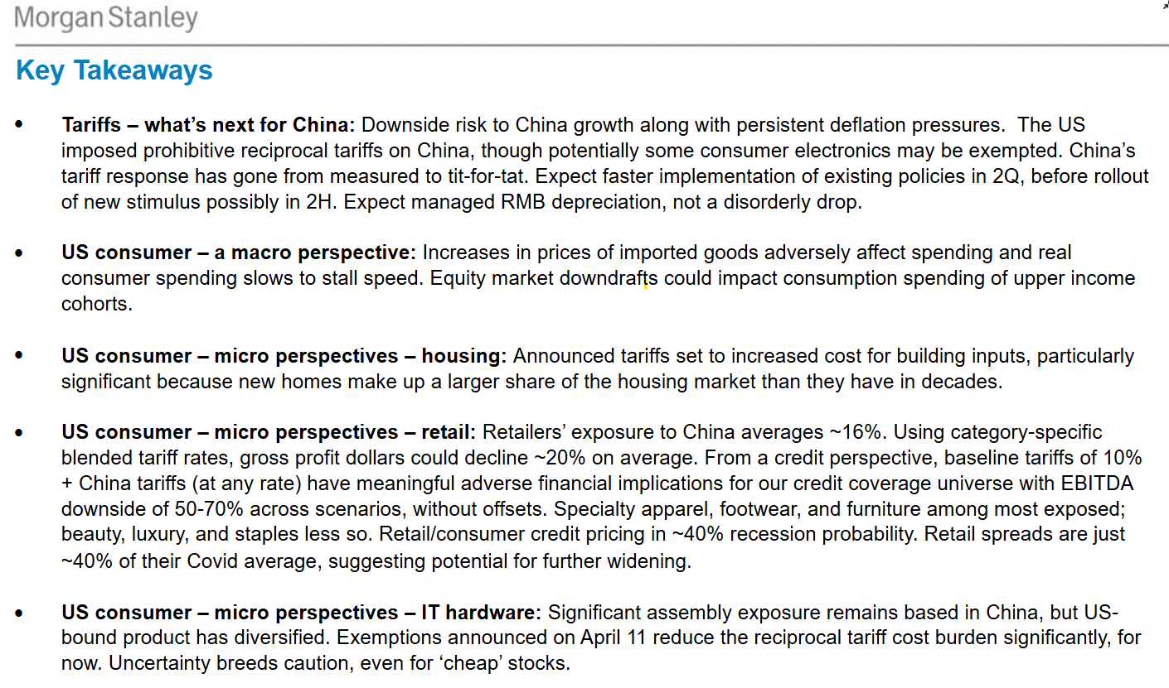
Export Growth Slowing

Slide 54
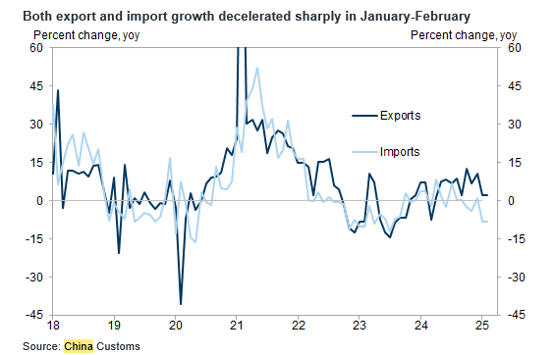
Export Growth Slowing
Source: UBS

Slide 55
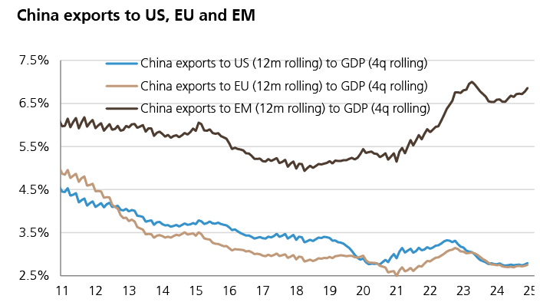
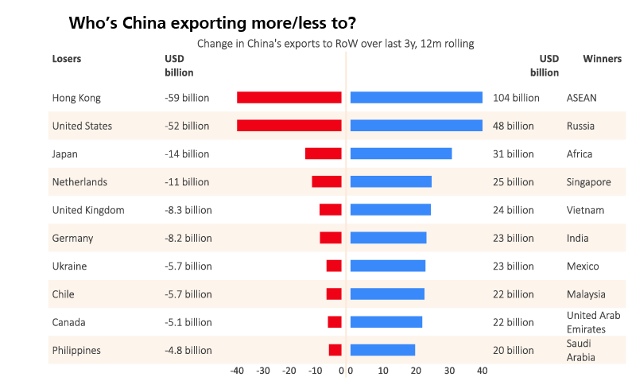
Export Breakdown
Source: UBS

Slide 56
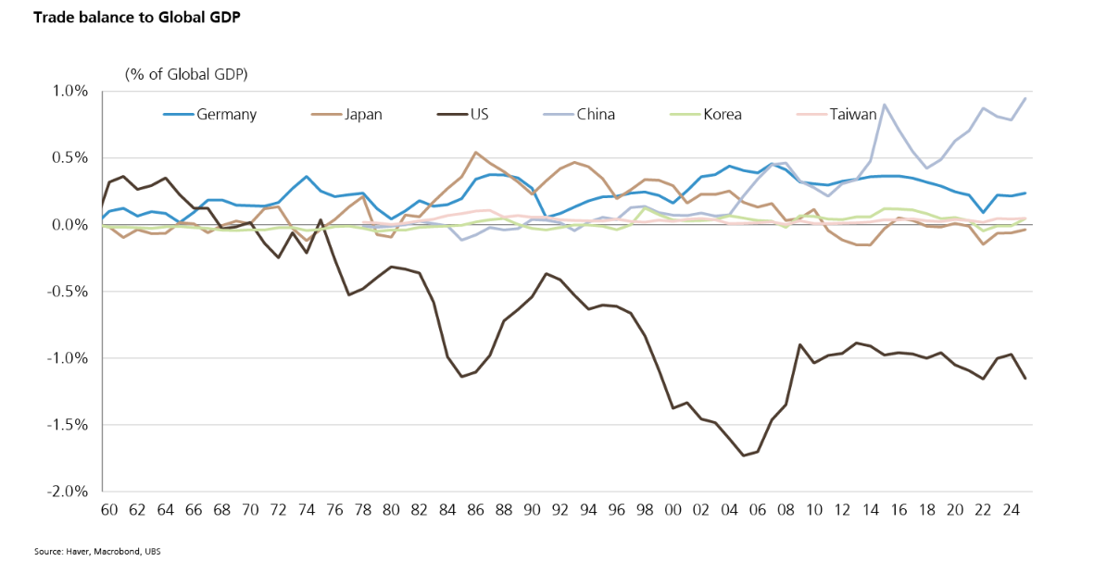
Trade Surplus Dynamic
Source: UBS

Slide 57
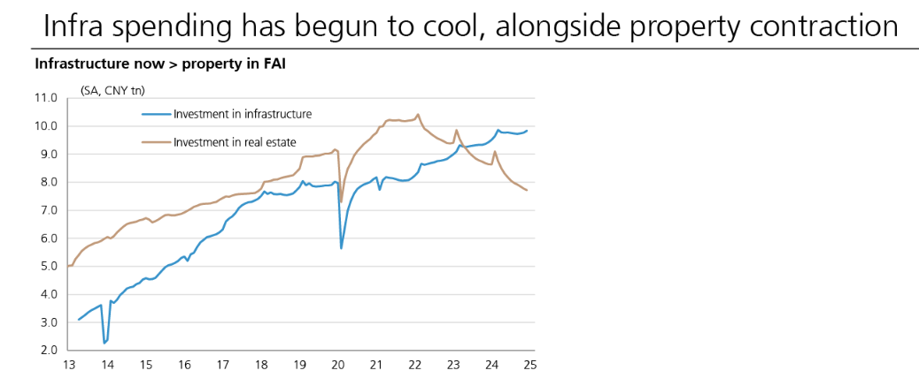
Real Estate vs Infrastructure

Slide 58
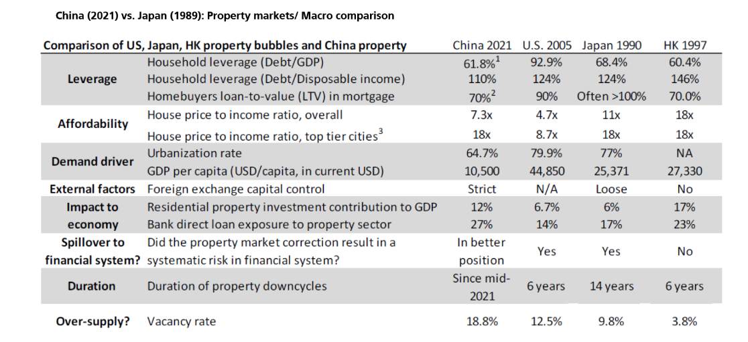
Housing Comparison

Slide 59
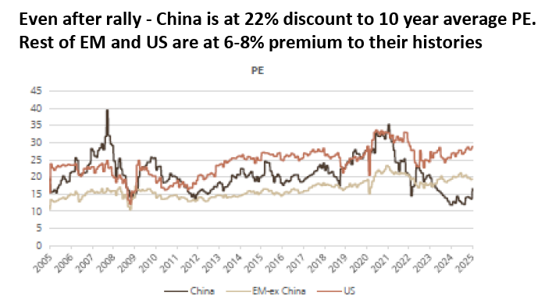
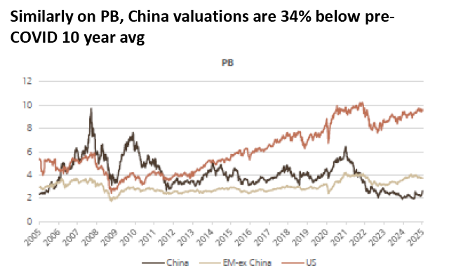
Valuation

Slide 60
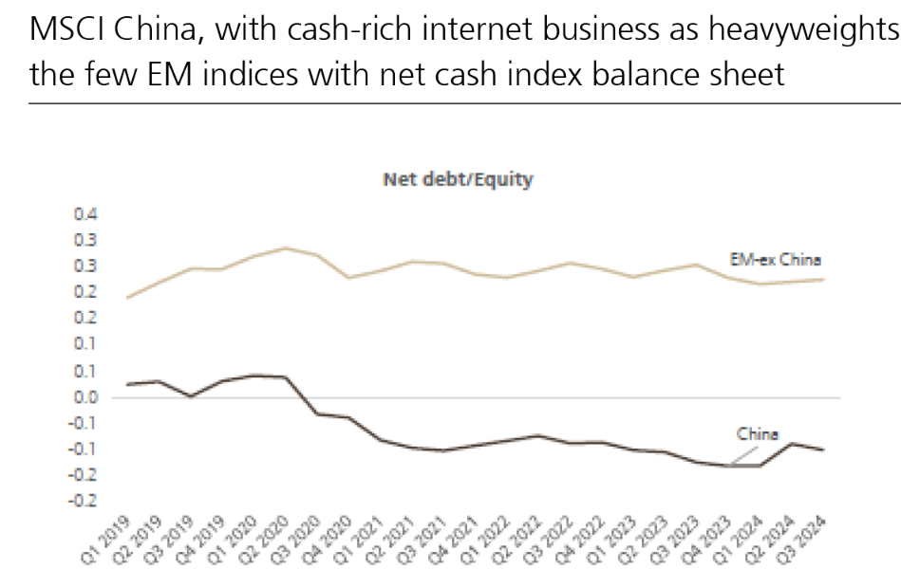
Chinese New Year

Slide 61
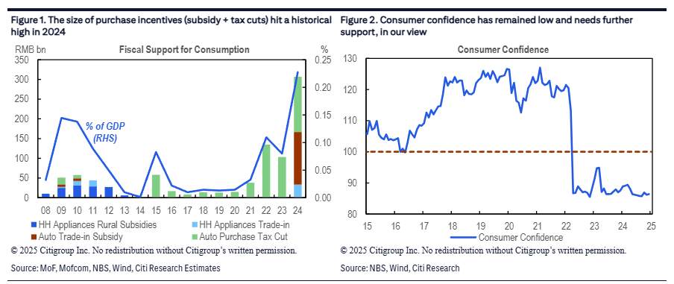


Stimulus

Slide 62
Contents
Guidelines:
Contents are fixed according to the meeting structure and are meant to be consistent across all investment platforms
Main Scenario – Cross Asset Research & Portfolio Construction
DM Rates
DM Equity
DM Credit
EM Equity
EM Debt
Global FX
Commodities
Hedging
Asset Class

Slide 63
EM Debt Focus Group
Debora Delbò, Plamen Todorov, Simona Tomaselli-Marzano

Slide 64
Liberation Day opened space for directional trades in EM
EM Spreads
EM Local Rates
+
=
On watch
EM SPREADS – MAINTAIN LONG EM SPREADS (via EM CDX)
We maintain LONG EM CDX position (1% / 0.04 yrs of sprd duration),
P&L since inception: 2bps (-49 bps spread)
EM LOCAL RATES – NEUTRAL
The 90-day US-China trade truce led to a spike in the USD which could potentially weigh on the ability of EM Central Banks to follow through with aggressive rate cuts
Differentiation across countries remains key, and we’re watching the space for potential trade proposals

Slide 65



EM spreads – how our trade performed?
A sharp spike in EM spreads was followed by an equally sharp
Encouragingly, the rally of the last few days was driven by cash bonds…
…as flows into the asset class resumed:

Slide 66
EM spread – now what?
We opt to keep the position open
We recognize that spreads have tightened significantly and value has eroded since we incepted the trade. However, we are still some distance away from the lows in December – January
Further significant tightening may be an uphill battle, but continious positive news flow on the trade front could keep the spreads at least at current level, benefitting our carry-positive position
The fact that investors are allocating back into the asset class provides further encourangment for maintanence of our position (at least for now)

Slide 67

EM local rates
The real defenesives
The 90-day US-China trade truce may to lead some reversion of the "lower growth & disinflation outside of the US / stagflation in the US" thesis
In turn, this means that we may see some reversal in the relative performance with low yielders underperforming high yielders
We continue to watch the space carefully as cross-currents and country-specific factors remain very crucial
As of 12 May 2025

Slide 68
Summary- strategy signals
Emerging local bond – positive stance
The best opportunities at 3m horizon are ) Latam (in particular Colombia, Brazil and Mexico), CEES (Turkey, Hungary and Romania). Czech and Romania are close to fairly valued in the short term but attractive at 3m horizon.
The expected return is +8.6% for the next 12 months, higher than US Treasury and HC bond, both in absolute and risk adjusted terms.
HC Bond – HY spread is expensive. IG is marginally expensive.
On the basis of our internal scenario, HY spread is expensive. IG is also expensive, but only slightly, considering the structural break in 2020.
The expected return for GBI is +8.6% for the next 12 months, higher than HC bond (6.2%) in absolute terms, very close to HC bond in risk adjusted terms (considering last year vol). Expected return similar for HY vs IG.

Slide 69
EMERGING LOCAL BOND –aggregated policy rate and nom. yields expected to move down. Inflation is touching the bottom, moving up in H2 2025.
GBI div weighted 10y nominal bond yields (reaggregated from bottom up data at country level) are expected to move down by about 30 bps in 12m.
Aggregated GBI weighted policy rates is at 6.3%, expected to move down to 5.5%.
Real GBI weighted 10y bond yield is trending up since the beginning of the year and now is 3.8%. It is expected to move down to 3% in the next 12 months.
On the other side, GBI weighted inflation is trending down and now is 3%. We see rising from Q2, peaking at the end of 2025 close to 3.8% and then moving down to 3.5% in H1 2026

Slide 70
EM Local bond (3m horizon) - Latam and CEEs favored.
The best opportunities at 3m horizon are:
1) Latam (in particular Colombia Brazil and Mexico)
2) CEES (Turkey, Hungary and Romania). Czech and Romania are close to fairly valued in the short term but attractive at 3m horizon.
3) Philippines is attractive at 3M horizon, while being close to FV in the short term.
Turkey
Y axis: current short term dislocation
X axis: ( 3m FWD expected delta yield =3m FV- current yield). The 3m FWD expected 10y yields has been calculated with internal models on the basis of 3m forward internal scenario: 10yUS=4.3 2yUS=3.6, WTI=61, CRB CMDTY =547, EUR= 1.11, internal CPI forecasts at country level, internal FX forecasts at country level, policy rates forecasts at country level.

Slide 71
EMBI SPREAD – Internal scenario is coherent with spread widening. Under the assumptions of 1) US10y yields at 4.15% and US2y yields at 3.5% 2) WTI trending to 60.5 3) EM –DM gap stabilizing in 2025 4) Vix moving gradually vs 18 (last 12m average), EMBI spread is going to widen in the next 12 months.

Slide 72
IG is marginally expensive considering the recent structural break (Nov 2020)

Slide 73
HY spread is confirmed expensive.

Slide 74
3M EXPECTED RETURNS
Considering that HY and IG have a very similar expected return, higher than EMBIG aggregated one, suggests a potential upside risk for the asset class.

Slide 75
12M EXPECTED RETURNS
Considering that HY and IG have a very similar expected return, higher than EMBIG aggregated one, suggests a potential upside risk for the asset class.

Slide 76
Contents
Guidelines:
Contents are fixed according to the meeting structure and are meant to be consistent across all investment platforms
Main Scenario – Cross Asset Research & Portfolio Construction
DM Rates
DM Equity
DM Credit
EM Equity
EM Debt
Global FX
Commodities
Hedging
Asset Class

Slide 77
Global FX
May 2025
• Document for professional investors only

Slide 78
Global FX monthly update – May 2025
The positive developments on trade and the recent surge in TWD hit the P&L over last month. Despite the environment is getting complex, we stick with the barbell positioning we have in place.
Overall we are risk-on through EMFX (Latam over Asia should work best in positive sentiment windows) and are net-risk-off within G10 (both the JPY and the EUR now work best in negative sentiment windows). On the USD, we think the trend is structural: as said last month we are ready to add on weakness.
[G10] We are slightly short USD and keep the relative preference: OW JPY, NOK, AUD & UW CHF.
We rebalance last month from a short EUR into a short USD. Any catch-up to relative rates will be to us opportunity to add.
We keep the long JPYCHF among long yielders. 1) JPY is the cheapest currency in G10, CHF is the most expensive; 2) JPY long-end is already above CHF, 3) we are in full Central Banks asynchrony here
No overload on cyclicals: AUD is relatively better placed.. The recent surge in TWD is getting dislocated, forward implied carry is huge and the spot is also getting rich according to our EM research.
[EM] : Latam (BRL + MXN) FX vs Asia (CNH)
We remain slightly short EMFX
We increased BRL and added small exposure to MXN last month
Despite the mild short, we have a Beta >1.
Source: Global FX, data as of April 2025

Slide 79

The USD – main convictions for the month
The USD correlation structure has changed, there’s little precedents to look for and this can have several implications from here. The USD is now positively correlated with equities and its correlation with US interest rates is now flat to negative. This to us means:
The USD lost portfolio construction characteristics and this per-se means lower demand than before
The best environment for the USD to sell-off goes in contrast with historical evidence (we set EURUSD @1.23 in a downside risk scenario and 1.10 for upside risk-scenario in 12M horizon. Baseline @1.17)
Improving trade talks are boosting risk-sentiment and short-term translate into USD strength as per the point above. This is also happening because of:
USD is diverging from rates differential
Consensus shifted rapidly short USD
Speculative and options positioning are short USD
If the sharp turn-around and the lack of visibility suggest to keep exposure low, we still see the USD bearish trend as the most likely.
The US rates advantage is not in line with growth differential (both data changes and data surprises are not showing a USD premium)
The Gold divergence with US real rates suggest the USD can undershoot rates differentials (as it happened in 2017-2018)
Steeper US curve is USD negative and lower tariffs should be less of a worry for inflation, thus the FED
The USD did not breach in April its fair valuation and real money have space to sell USDs
The more equities rebound the higher the more the asymmetry gets negative (the world will still see higher tariffs than before)
Lower tariffs cut downside for the RoW and will not redirect aggregate demand towards the US (given the lower trade-off)
Upside triggers (USD+)
Renewed spikes in oil, boost in risk-sentiment and US rates moving higher
USD funding lines breaking-up and leading to surge in USD demand
Downside risks (USD-)
Faster correction in inflation with no recession and the FED cutting rates (Goldilocks for longer)
US slowing down, with a reacceleration in sentiment in the RoW
Sharp deterioration in activity forcing the FED to cut aggressively

Slide 80

1. The USD correlation structure has changed
The USD is losing its role in PTF construction.
In the last 15 years demand for USDs was not just function of US exceptionalism. Portfolio construction features were big part of the equation. Yet this also means that when risk-sentiment bounces, the USD follows (as it happens right now)
Source: Amundi Institute, Bloomberg, data as of May 09, 2025

Slide 81


1.1 The USD is undershooting rates differential
DXY should trade around 106 based on implied policy rates differential.
Source: Amundi Institute, Bloomberg, data as of May 09, 2025

Slide 82


1.2 Fair Valuation was not even breached in April
This is the case even for models that take into account relative productivity and degree of openness of G10 economies
Source: Amundi Institute, Bloomberg, data as of April 30, 2024

Slide 83


1.3 Real money have still space to sell USDs
This is the evidence we get from State Street
Source: Amundi Institute, Bloomberg, data as of May 02, 2025

Slide 84

2. How to deal with TWD
Sudden USDTWD move doesn’t change our view
An abrupt move of USDTWD in a low liquidity holiday period caught market by surprise, two-day -7% on spot and -12% in 3 month NDF outright, a 3-sigma event for a 4% realized volatility cross.
The move is supposed to be linked with exporters selling USD after record Q1 export soar (+30% y/y in April) driven by front-loading activities ahead of impeding US reciprocal tariffs.
Local banks disappeared from USDTWD bid and CBC (a vol-targeting central bank) refrained to intervene in a dislocated market not wanting to appear as currency manipulator amid US bilateral trade talks.
When dust settled, USDTWD recovered almost half the move. Whilst it remains unclear whether currency is playing a role in negotiation, local lifers are extremely long USD assets (around 140% of GDP) and, as most players around the world, have low hedged exposure given the cost. Having said that it’s a long term historic position and not in their interest to create volatility hedging or selling USD asset exposure.
Even with post-event jump in 3m implied volatility (from 7% to a 13% high back to 10% now) TWD neg carry-to-vol vs USD remains high (0.77) and long AUDTWD annualized 3m carry is trading now at +7%. In other term, the spot move was joined by a move lower in fwd points in a totally dislocated way (graph below).
This make sense as far as market is pricing more dollar weakness ahead, but enhance TWD role as funding currency with carry at historical high, considering also the effect on growth of a stronger currency for an export-oriented economy like Taiwan (exports account for around 70% of GDP).
We will monitor the situation but actually we think that on a relative perspective AUD/TWD long still make a lot of sense on fundamental and carry perspective.
Source: Amundi Institute, Bloomberg, data as of May 13, 2025

Slide 85

3. Our EMFX preference (Latam vs CNH)
DXY should trade around 106 based on implied policy rates differential.
The long BRL and MXN position vs CNH is more and more a long beta position, thus good proxy for EM FX as a whole. The more the market is in risk-on mode, the more MXN and BRL will perform well, better than other EM FX, CNH included
The sudden and shocking TWD rally cannot happen (in that scale) for CNH: No same Possible agreement with the US to lower the tariffs vs strengthening TWD No distort USD asset positions, non hedged, like the ones of Taiwan Lifers
Trade agreements between Brazil and China, oil price above 60, US economy not in distress are reinforcing BRL and MXN way more than CNH
Source: Amundi Institute, Bloomberg, data as of May 09, 2025

Slide 86
Appendix

Slide 87


2.2 The rapid shift in consensus is always a risk
In FX, being consensus is always a risk and the surge in expectations are a headwind from here. Yet we remain far from the improved valuation and it has been mostly a mark-to-market story
Source: Amundi Institute, Bloomberg, data as of May 09, 2024

Slide 88

2.3 Speculative and option positioning are short USD
Fast money and risk-reversals are telling
Source: Amundi Institute, Bloomberg, data as of May 09, 2025

Slide 89


3. Growth differential are less USD positive though
Both data changes and data surprises are not aligned with huge US rates advantage, despite the weak profiles out of the US
Source: Amundi Institute, Bloomberg, data as of May 09, 2025

Slide 90


3.1 Gold decoupling and YC steepening support USD- trend
Gold has decoupled with RY since a while, rates differential can fade to drive FX like it happened in 2017-early 2018 and YC steepening is USD-
Source: Amundi Institute, Bloomberg, data as of May 09, 2025

Slide 91
3.4 The US equities rebound still has problems
The US will at least pay part of the economic cost. A headwind given expectations did not capitulate yet. Moreover, redirecting trade flows (which seems to be the goal of the US administration) can only be achieved in a weak USD window
Three possible scenarios for US tariffs
 | Perfect currency offset | No currency offset (1) | No currency offset (2)
Trade-partners FX | Exporters' currencies depreciate by the same amount of the tariffs increase | Exporters do not let their currencies to depreciate much | Exporters do not let their currencies to depreciate much
Incidence | Tariffs are paid by the tariffed nation (reduced purchasing power and wealth from weaker currency) | Tariffs are paid by US consumers as imported goods cost more | Tariffs are paid by US corporates as the higher import prices are absorbed by margins
US Inflation | Non-inflationary (after tariffs USD price unchanged) | Inflationary (after tariffs, USD prices rise) | Non-inflationary (margins absorb the costs)
Trade flows | As import prices do not increase there are little effects on trade-flows. As the USD strengthens, this hit exports) | Rebalancing is achieved over time as imports get more expensive relative to domestic production | Rebalancing is achieved over time as imports get more expensive relative to domestic production
Revenues | The Treasury raises revenues | The Treasury raises revenues at first, but as trade rebalances away from tariffed goods, less revenues are raised over time | The Treasury raises revenues at first, but as trade rebalances away from tariffed goods, less revenues are raised over time
US Growth | Marginal directional impact on growth | Higher consumer prices should drag US growth, all else being equal | Lower margins should drag US Earnings
Source: Hudson Bay Capital, Amundi Investment Institute. February 2025

Slide 92



3.4 The US equities rebound still has problems
SP500 EPS downward revision is not extreme and still open up for negative surprises. Peaking relative growth may gradually require a shift in capital allocation
Source: Amundi Investment Institute, Data is as of April 29, 2025

Slide 93


4. Capital repatriation remains a theme
Foreign holdings of USD securities at all time high. The starting point may favour a de-dollarization wave. This can also turn out to be a tool to counteract the US administration threats on trade.
Source: Department of the Treasury/Federal Reserve Board, TIC, Amundi Investment Institute. Feb 2025, which refers to data as of June 2024 (annual data)
Source: Amundi Institute, Bloomberg, data as of April 28, 2025

Slide 94

4.1 Capital repatriation remains a theme
Bonds flows are a positive for EURUSD this time. The capital we have allocated into US debt is huge. Repatriation or higher hedge ratios in bonds allocation is a headwind for the USD, in our view.
Source: Amundi Institute, Bloomberg, data as of January 31, 2025

Slide 95
Contents
Guidelines:
Contents are fixed according to the meeting structure and are meant to be consistent across all investment platforms
Main Scenario – Cross Asset Research & Portfolio Construction
DM Rates
DM Equity
DM Credit
EM Equity
EM Debt
Global FX
Commodities
Hedging
Asset Class

Slide 96
Commodities Update – Strategy Day
Investment Institute
MAY 2025
• Document for professional investors only

Slide 97
Commodities – overview / proposal
Oil: possibly slight undervaluation, but MT downside remains
High volatility due to tariff on/off messaging
Fundamental outlook for 2025 not appealing: OK demand growth likely to meet strong supply growth, no OPEC price support anymore
We propose to keep the neutral position
Gold: strong CB purchases should continue to support prices
Risks still skewed to the upside (fiscal policies, debt sustainability, CBs $-non-aligned purchase, geopolitical risk, tariffs etc.)
Risks: Ukraine ceasefire, consensus trade, trade war detente
We propose to maintain the current overweight, with trailing stop-loss @-10%
Base Metals: positive LT outlook, cautious ST
Positive: AI demand, energy transition, Chinese stimulus, firming metal demand thanks to a somewhat more friendly economic cycle
Negative: prospects of trade war, structural Chinese decline, less upside from the energy transition due to policy delays
We propose to keep the neutral position

Slide 98
Contents
Guidelines:
Contents are fixed according to the meeting structure and are meant to be consistent across all investment platforms
Main Scenario – Cross Asset Research & Portfolio Construction
DM Rates
DM Equity
DM Credit
EM Equity
EM Debt
Global FX
Commodities
Hedging
Asset Class

Slide 99
Safe Asset & Hedging Group Strategy Day
Sponsor: Shane McDonald
Coordinator: Antonio Motta
Focus Group: Berthon Jean Baptiste; Bruder Benjamin; Codari Matteo; Galassi Pasquale; Gallo Roberto; Mahallati Ali; McDonald Shane; Mercante Giulia; Motta Antonio; Nitescoux Alexandra
MAY 2025
• Document for professional investors only

Slide 100
Contents
Strategy performance, risk & new proposals overview & analysis
Strategy portfolio positioning
Portfolio Historical Analysis
Risk Survey & Scenarios
Asset Class Analysis
Appendix

Slide 101
Strategy performance, risk overview and analysis
01

Slide 102



Strategy Performance & Risk Overview
102

Slide 103





Strategy Performance & Risk Overview
⇥
⇥
+
⇧
103

Slide 104

Portfolio Exposure
104

Slide 105

Portfolio Stress Tests

Slide 106
Risk Survey & Scenarios
02

Slide 107




Macro Scenario | Central and alternative scenarios by probability
Probability 70%
Probability 25%
Probability 5%
MAIN SCENARIO Growth at risk
DOWNSIDE SCENARIO High protectionism here to stay
UPSIDE SCENARIO Return of international cooperation
GEOPOLITICS
Tariffs stabilise at around 20% in US, with limited reprisals elsewhere. Slow onshoring of supply chains. Ukraine-Russia: ongoing fighting. Middle East: talks and conflicts likely. China-US: relations remain tense. US-Europe: relations strained. | A more permanent breakdown in advanced country cooperation. Countries forced to choose between the US and China. Global trade begins to decline. | Geopolitical risk subsides. Global trade flows change but continue, fostering balanced growth and prosperity.
Fed cuts three times despite US stagflation risk. ECB cuts rates to 1.50%. Most EM CBs at peak rates. China continues to ease. Divergent fiscal policies: US mild tax cuts and mild spending cuts. EU defence spending halts consolidation; China expands. | Liquidity risks and bankruptcies increase. A crisis event forces central banks to cut even though inflation remains high. Global capital flows decline. High fiscal deficits increase term premia and funding costs. | Cooperation to reduce protectionism stabilises markets. Inflation falls below targets, giving central banks room to cut to bolster growth.
Global growth hurt by tariffs, delaying return to potential growth. EM continues to grow faster. India’s growth potential revised up. | Protectionism and reduced immigration into advanced economies lower labour supply and growth. Lack of labour reform keeps growth potential low. | Deregulation and new technologies (AI) boost growth. Protectionism subsides and industrial policies boost investment.
Climate change hampers growth and exacerbates stagflationary trends. Chinese dominance in critical minerals. | Climate events increase, destroying capital. | From zero to hero: geo-engineering, globally coordinated policies.
GEOPOLITICS
INFLATION & POLICY MIX
INFLATION & POLICY MIX
GROWTH
PATH
GROWTH PATH
CLIMATE CHANGE
CLIMATE
CHANGE
Source: Amundi Investment Institute as of 7 May 2025. DM: developed markets, EM: emerging markets. CB: central banks. Fed: Federal Reserve. ECB: European Central Bank. EZ: Eurozone.

Slide 108
Risks to watch | Risks to the main scenario
LOW
Probability
HIGH
10%
15%
15%
20%
Buyers strike on US Treasuries
Geopolitical crisis with global spillovers
Drying financial conditions lead to credit event
Reacceleration of DM inflation, due to trade/geopolitical tensions
Positive for cash and gold. | Positive for some DM govies, cash, gold, USD, volatility, defensive assets and oil. | Positive for cash, gold and DM government bonds. | Positive for TIPS, gold, commodity FX, and real assets.
Negative for govies and expensive equities. | Negative for credit, equities, and EM. | Negative for risk assets. | Negative for bonds, equities, DM FX, and EM assets.
MARKET IMPACT
Source : Amundi Investment Institute as of 23 April 2025. DM: developed markets. EM: emerging markets. CB: central banks. USD: US dollar. TIPS: Treasury inflation-protected securities. FX: foreign exchange markets.

Slide 109

What are you most concerned thinking about the Total return of Strategic Portfolio?
Economic concerns
Political concerns
Market
dynamics
Inflation
Stagflation in US
+1
Tariffs (no deal)
US loss of credibility
anaemic return vs fixed income short term
2
2
+3
More geopolitical issues in Asia
China US tensions
Wider spreads
Changing world equilibrium

Slide 110
What are you most concerned thinking about the Active return of Strategic Portfolio?
Economic concerns
Political concerns
Market
dynamics
Inflation
Stagflation in US
+1
Tariffs (no deal)
US loss of credibility
US Equities Valuations and divergence with other Equity markets
2
+2
Emerging Markets weakness
Changing world equilibrium

Slide 111
Asset Class Analysis
03

Slide 112


Equity Volatility smile
Insert a new slide:
Click on Home menu / Slides / New Slide
Select the appropriate slide in the Gallery.
Change the layout of slide:
Click on Home menu / Slides / New Slide,
Select the appropriate slide in the Gallery.
VOLATILITY |  | 3M ASSESSMENT |  |  |  |  |  | CONVICTION | ASSET CLASS RETURNS |  | 3M ASSESSMENT RATIONALE
 | TICKER | -- | - | =/- | =/+ | + | ++ | Level | Since Last committee | Since Last change in view
VEquity | VIX Index |  |  |  | x |  |  |  | + | + | Current skew and implied vol decreased from last month. Implied vol increased since last month. The vol is considered attractive. Market very dependent on short term news.
Change text level to another one:
In the Home menu:
click to the following buttons
With the tab key:
Next level
Previous level
 With the tab key, it is advisable to select all the text to change level
⇥
⇥
+
⇧

Slide 113

Equity implied volatilities vs long term history
Insert a new slide:
Click on Home menu / Slides / New Slide
Select the appropriate slide in the Gallery.
Change the layout of slide:
Click on Home menu / Slides / New Slide,
Select the appropriate slide in the Gallery.
Current values quantiles in the distributions since 2012
Change text level to another one:
In the Home menu:
click to the following buttons
With the tab key:
Next level
Previous level
 With the tab key, it is advisable to select all the text to change level
⇥
⇥
+
⇧
113

Slide 114

Current volatility structure
Insert a new slide:
Click on Home menu / Slides / New Slide
Select the appropriate slide in the Gallery.
Change the layout of slide:
Click on Home menu / Slides / New Slide,
Select the appropriate slide in the Gallery.
Change text level to another one:
In the Home menu:
click to the following buttons
With the tab key:
Next level
Previous level
 With the tab key, it is advisable to select all the text to change level
⇥
⇥
+
⇧
114

Slide 115




Rates – EU vs US
115

Slide 116
Rates – Volatility improved but still high
116

Slide 117



Cross assets volatility
Insert a new slide:
Click on Home menu / Slides / New Slide
Select the appropriate slide in the Gallery.
Change the layout of slide:
Click on Home menu / Slides / New Slide,
Select the appropriate slide in the Gallery.
Change text level to another one:
In the Home menu:
click to the following buttons
With the tab key:
Next level
Previous level
 With the tab key, it is advisable to select all the text to change level
⇥
⇥
+
⇧
117

Slide 118


Credit vol back to cheap levels
Insert a new slide:
Click on Home menu / Slides / New Slide
Select the appropriate slide in the Gallery.
Change the layout of slide:
Click on Home menu / Slides / New Slide,
Select the appropriate slide in the Gallery.
Change text level to another one:
In the Home menu:
click to the following buttons
With the tab key:
Next level
Previous level
 With the tab key, it is advisable to select all the text to change level
⇥
⇥
+
⇧
118

Slide 119
Appendix
04

Slide 120
Hedging Book – FX
Positive developments in trade negotiations results in a USD stabilization and lower implied volatility, but the tariffs situation is far from solved and the USD structural depreciation trend remains in place. USD lost correlation with US rates, while regained correlation with USD equity.
CHF and JPY continue to trade as haven amid rebounding equity markets.
-100
-50
0
50
100
VOLATILITY |  | 3M ASSESSMENT |  |  |  |  |  | CONVICTION | 3M ASSESSMENT RATIONALE
 | TICKER | -- | - | =/- | =/+ | + | ++ | Level
VFX | CVIX3I Index |  |  |  |  | X |  | 2 | FX volatilities retraced back to less expensive levels, but uncertainty is far from gone.
120

Slide 121

Detailed Portfolio Exposure
121

Slide 122

Detailed Portfolio Exposure
122

Slide 123

Insert a new slide:
Click on Home menu / Slides / New Slide
Select the appropriate slide in the Gallery.
Change the layout of slide:
Click on Home menu / Slides / New Slide,
Select the appropriate slide in the Gallery.
Correlation Analysis
Change text level to another one:
In the Home menu:
click to the following buttons
With the tab key:
Next level
Previous level
 With the tab key, it is advisable to select all the text to change level
⇥
⇥
+
⇧
123

Slide 124


Insert a new slide:
Click on Home menu / Slides / New Slide
Select the appropriate slide in the Gallery.
Change the layout of slide:
Click on Home menu / Slides / New Slide,
Select the appropriate slide in the Gallery.
Correlation Analysis
Change text level to another one:
In the Home menu:
click to the following buttons
With the tab key:
Next level
Previous level
 With the tab key, it is advisable to select all the text to change level
⇥
⇥
+
⇧
124

Slide 125
Contents
Guidelines:
Contents are fixed according to the meeting structure and are meant to be consistent across all investment platforms
Main Scenario – Cross Asset Research & Portfolio Construction
DM Rates
DM Equity
DM Credit
EM Equity
EM Debt
Global FX
Commodities
Hedging
Asset Class

Slide 126
Macro Strategy Day
Focus Groups - Portfolio Construction
May 14th, 2025

Slide 127

Asset Class Agenda
Insert a new slide:
Click on Home menu / Slides / New Slide
Select the appropriate slide in the Gallery.
Change the layout of slide:
Click on Home menu / Slides / New Slide,
Select the appropriate slide in the Gallery.
Change text level to another one:
In the Home menu:
click to the following buttons
With the tab key:
Next level
Previous level
 With the tab key, it is advisable to select all the text to change level
⇥
⇥
+
⇧

Slide 128
Portfolio overview
01

Slide 129

Portfolio Overview – Active Exposure
Insert a new slide:
Click on Home menu / Slides / New Slide
Select the appropriate slide in the Gallery.
Change the layout of slide:
Click on Home menu / Slides / New Slide,
Select the appropriate slide in the Gallery.
Change text level to another one:
In the Home menu:
click to the following buttons
With the tab key:
Next level
Previous level
 With the tab key, it is advisable to select all the text to change level
⇥
⇥
+
⇧

Slide 130

Portfolio Overview – Active Risk
Insert a new slide:
Click on Home menu / Slides / New Slide
Select the appropriate slide in the Gallery.
Change the layout of slide:
Click on Home menu / Slides / New Slide,
Select the appropriate slide in the Gallery.
Change text level to another one:
In the Home menu:
click to the following buttons
With the tab key:
Next level
Previous level
 With the tab key, it is advisable to select all the text to change level
⇥
⇥
+
⇧

Slide 131

Portfolio Overview – Risk by Strategy
Insert a new slide:
Click on Home menu / Slides / New Slide
Select the appropriate slide in the Gallery.
Change the layout of slide:
Click on Home menu / Slides / New Slide,
Select the appropriate slide in the Gallery.
Change text level to another one:
In the Home menu:
click to the following buttons
With the tab key:
Next level
Previous level
 With the tab key, it is advisable to select all the text to change level
⇥
⇥
+
⇧

Slide 132

Portfolio Overview – Correlation
Insert a new slide:
Click on Home menu / Slides / New Slide
Select the appropriate slide in the Gallery.
Change the layout of slide:
Click on Home menu / Slides / New Slide,
Select the appropriate slide in the Gallery.
Change text level to another one:
In the Home menu:
click to the following buttons
With the tab key:
Next level
Previous level
 With the tab key, it is advisable to select all the text to change level
⇥
⇥
+
⇧

Slide 133
Asset Class Groups
02

Slide 134

EM Debt - Strategy Performance & Risk Overview
Insert a new slide:
Click on Home menu / Slides / New Slide
Select the appropriate slide in the Gallery.
Change the layout of slide:
Click on Home menu / Slides / New Slide,
Select the appropriate slide in the Gallery.
Change text level to another one:
In the Home menu:
click to the following buttons
With the tab key:
Next level
Previous level
 With the tab key, it is advisable to select all the text to change level
⇥
⇥
+
⇧

Slide 135

EM Debt - Agenda
Insert a new slide:
Click on Home menu / Slides / New Slide
Select the appropriate slide in the Gallery.
Change the layout of slide:
Click on Home menu / Slides / New Slide,
Select the appropriate slide in the Gallery.
Change text level to another one:
In the Home menu:
click to the following buttons
With the tab key:
Next level
Previous level
 With the tab key, it is advisable to select all the text to change level
⇥
⇥
+
⇧

Slide 136

EM Equity - Strategy Performance & Risk Overview
Insert a new slide:
Click on Home menu / Slides / New Slide
Select the appropriate slide in the Gallery.
Change the layout of slide:
Click on Home menu / Slides / New Slide,
Select the appropriate slide in the Gallery.
Change text level to another one:
In the Home menu:
click to the following buttons
With the tab key:
Next level
Previous level
 With the tab key, it is advisable to select all the text to change level
⇥
⇥
+
⇧

Slide 137

EM Equity - Agenda
Insert a new slide:
Click on Home menu / Slides / New Slide
Select the appropriate slide in the Gallery.
Change the layout of slide:
Click on Home menu / Slides / New Slide,
Select the appropriate slide in the Gallery.
Change text level to another one:
In the Home menu:
click to the following buttons
With the tab key:
Next level
Previous level
 With the tab key, it is advisable to select all the text to change level
⇥
⇥
+
⇧

Slide 138

Commodities - Strategy Performance & Risk Overview
Insert a new slide:
Click on Home menu / Slides / New Slide
Select the appropriate slide in the Gallery.
Change the layout of slide:
Click on Home menu / Slides / New Slide,
Select the appropriate slide in the Gallery.
Change text level to another one:
In the Home menu:
click to the following buttons
With the tab key:
Next level
Previous level
 With the tab key, it is advisable to select all the text to change level
⇥
⇥
+
⇧

Slide 139
Commodities - Agenda
Insert a new slide:
Click on Home menu / Slides / New Slide
Select the appropriate slide in the Gallery.
Change the layout of slide:
Click on Home menu / Slides / New Slide,
Select the appropriate slide in the Gallery.
Change text level to another one:
In the Home menu:
click to the following buttons
With the tab key:
Next level
Previous level
 With the tab key, it is advisable to select all the text to change level
⇥
⇥
+
⇧

Slide 140

DM Credit - Strategy Performance & Risk Overview
Insert a new slide:
Click on Home menu / Slides / New Slide
Select the appropriate slide in the Gallery.
Change the layout of slide:
Click on Home menu / Slides / New Slide,
Select the appropriate slide in the Gallery.
Change text level to another one:
In the Home menu:
click to the following buttons
With the tab key:
Next level
Previous level
 With the tab key, it is advisable to select all the text to change level
⇥
⇥
+
⇧

Slide 141

DM Credit - Agenda
Insert a new slide:
Click on Home menu / Slides / New Slide
Select the appropriate slide in the Gallery.
Change the layout of slide:
Click on Home menu / Slides / New Slide,
Select the appropriate slide in the Gallery.
Change text level to another one:
In the Home menu:
click to the following buttons
With the tab key:
Next level
Previous level
 With the tab key, it is advisable to select all the text to change level
⇥
⇥
+
⇧

Slide 142


Global FX - Strategy Performance & Risk Overview
Insert a new slide:
Click on Home menu / Slides / New Slide
Select the appropriate slide in the Gallery.
Change the layout of slide:
Click on Home menu / Slides / New Slide,
Select the appropriate slide in the Gallery.
Change text level to another one:
In the Home menu:
click to the following buttons
With the tab key:
Next level
Previous level
 With the tab key, it is advisable to select all the text to change level
⇥
⇥
+
⇧

Slide 143

Global FX - Agenda
Insert a new slide:
Click on Home menu / Slides / New Slide
Select the appropriate slide in the Gallery.
Change the layout of slide:
Click on Home menu / Slides / New Slide,
Select the appropriate slide in the Gallery.
Change text level to another one:
In the Home menu:
click to the following buttons
With the tab key:
Next level
Previous level
 With the tab key, it is advisable to select all the text to change level
⇥
⇥
+
⇧

Slide 144


DM Rates - Strategy Performance & Risk Overview
Insert a new slide:
Click on Home menu / Slides / New Slide
Select the appropriate slide in the Gallery.
Change the layout of slide:
Click on Home menu / Slides / New Slide,
Select the appropriate slide in the Gallery.
Change text level to another one:
In the Home menu:
click to the following buttons
With the tab key:
Next level
Previous level
 With the tab key, it is advisable to select all the text to change level
⇥
⇥
+
⇧

Slide 145

DM Rates - Agenda
Insert a new slide:
Click on Home menu / Slides / New Slide
Select the appropriate slide in the Gallery.
Change the layout of slide:
Click on Home menu / Slides / New Slide,
Select the appropriate slide in the Gallery.
Change text level to another one:
In the Home menu:
click to the following buttons
With the tab key:
Next level
Previous level
 With the tab key, it is advisable to select all the text to change level
⇥
⇥
+
⇧

Slide 146


DM Equity - Strategy Performance & Risk Overview
Insert a new slide:
Click on Home menu / Slides / New Slide
Select the appropriate slide in the Gallery.
Change the layout of slide:
Click on Home menu / Slides / New Slide,
Select the appropriate slide in the Gallery.
Change text level to another one:
In the Home menu:
click to the following buttons
With the tab key:
Next level
Previous level
 With the tab key, it is advisable to select all the text to change level
⇥
⇥
+
⇧

Slide 147

DM Equity - Agenda
Insert a new slide:
Click on Home menu / Slides / New Slide
Select the appropriate slide in the Gallery.
Change the layout of slide:
Click on Home menu / Slides / New Slide,
Select the appropriate slide in the Gallery.
Change text level to another one:
In the Home menu:
click to the following buttons
With the tab key:
Next level
Previous level
 With the tab key, it is advisable to select all the text to change level
⇥
⇥
+
⇧

